Slide 1

Enhancing Student Success through Innovative Practices: USC's CircleIn Pilot Project
Lydia Frass, Dir. Assessment & Distributed Learning, CAS
Jan Bass, Senior Assoc. Dean, Darla Moore School
Chris Glenski, Senior Lecturer, Darla Moore School
Suzanne Sutton, Asst. Professor & Academic Success Coordinator, Nursing
(with Lara Lomicka Anderson, Vice Provost)
Notes:
[Lydia]
Improving learning outcomes and retention rates requires that faculty often take multi-faceted approaches to reach students. Since Fall 2023, USC has been piloting the CircleIn App in several courses with the aim of improving student retention and student learning outcomes.
CircleIn is a multi-tool study app built on the pedagogical frameworks of peer-led learning and gamification.
In this presentation, we will share the outcomes from the first year of this pilot project and lead discussions to learn what other pedagogical methods faculty are using to engage students, improve learning outcomes and decrease DFW rates in their own classes.
USC’s two-year pilot project with CircleIn aims to leverage peer-led learning and supplemental instruction to reduce DFW rates and promote equity for underserved student populations. The project integrates HIPs (peer learning, supplemental instruction) into the curriculum in bottleneck courses. CircleIn enhances students' learning experiences and academic success by providing them with personalized study space, collaborative learning opportunities with peers, and access to supplemental instruction. With CircleIn, students can ask questions, create flashcards, share study materials, and reflect on their progress in the course. Research has demonstrated that peer-led initiatives not only improve academic performance but also foster a sense of belonging and community among students who may otherwise feel marginalized or isolated. We will share results of year 1 of the pilot study, including DFW shifts and ABC pass rates.

Slide 2
Abstract (Session Description in notes)
Hidden slide
This session showcases USC’s two-year pilot with CircleIn, a virtual student community aimed at enhancing retention and graduation rates by leveraging peer-led learning and supplemental instruction to reduce DFW rates, build community and promote equity for underserved students. CircleIn provides students with personalized study space, collaborative learning opportunities with peers, and access to supplemental instruction. Research has demonstrated that peer-led initiatives not only improve academic performance but also foster a sense of belonging and community among students who may otherwise feel marginalized or isolated. We will share results of year 1 of the pilot study, including grade changes.
Notes:
Attendees will gain valuable insights into USC’s innovative two-year pilot project with CircleIn, a cutting-edge virtual student community. This initiative aims to increase retention and graduation rates while promoting an inclusive academic environment that bridges the gap between students, student success teams, and faculty members. At the core of this project lies the strategic integration of High-Impact Practices (HIPs), such as peer-led learning and supplemental instruction, into the curriculum of bottleneck courses. Attendees will learn how to leverage these evidence-based pedagogical approaches to reduce the rates of students dropping, failing, or withdrawing (DFW) from courses, thereby promoting equity and academic achievement for underserved student populations. CircleIn serves is a platform that enhances students' learning experiences, academic success, and empowers students to actively engage with course material by asking questions, creating flashcards, sharing study materials, and reflecting on their progress throughout the course.
Research has demonstrated that peer-led initiatives improve academic performance and cultivates a profound sense of belonging and community among students who may otherwise feel marginalized or isolated within the academic landscape. Attendees will gain insights into fostering a supportive and collaborative environment so no student is left behind. During this session, attendees will have the opportunity to analyze and discuss the results of the first year of the pilot study, including the project's impact on DFW rates and ABC pass rates in targeted courses, as well as the impact of supplemental instructors within the project.
Through interactive discussions and Q/A, attendees will learn more about (1) integrating supplemental instruction into bottleneck courses to reduce DFW rates and promote equity, (2) using virtual platforms like CircleIn, and (3) implementing peer-led learning. Participants will gain valuable insights and practical strategies to enhance student success, promote equity, and foster a supportive academic community on their respective campuses.

Slide 3
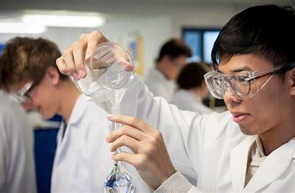
Why CircleIn?
Bottleneck courses
High DFW rates → sciences, math, accounting, and computing
High DFW rates have a negative impact on:
  Progression
  Retention
  Scholarships
  Financial Aid
  Overall Tuition Cost
  Graduation
High Impact Practices:
  Collaborative / peer lead learning
  Sense of belonging
  Supplemental Instruction
Notes:
[JAN]

Slide 4
Why CircleIn?
Virtual peer-led community promotes student engagement with each other and with course content
Builds on gamification research and collaborative learning to:
  increase student learning
  increase student retention
  ensure all students are included
Incorporates tools that students use in one app:
  Similar to What’sApp, GroupMe, Quizlet and Zoom combined in 1
NSF Grant Funded
USC Goal: Decrease DFW rates & academic gaps
Notes:
[JAN]

Slide 5
Faculty & SSC Partnership
Faculty
Student Success Center
Adds CircleIn details to syllabus
Adds tutorial and support content to Bb
Discusses CI use with SI Leader
Discusses app use with class within 1st week (discourage use of other apps)
Encourages students to complete weekly reflection
Reviews student feedback and incorporate into next classes
Assigned SI Leaders to pilot classes
Trained the SI on Circle In
SI promotes use to students
SI monitors their class in CircleIn
Responds to students in CI
Discusses CI use with their lead faculty
Notes:
[JAN]

Slide 6
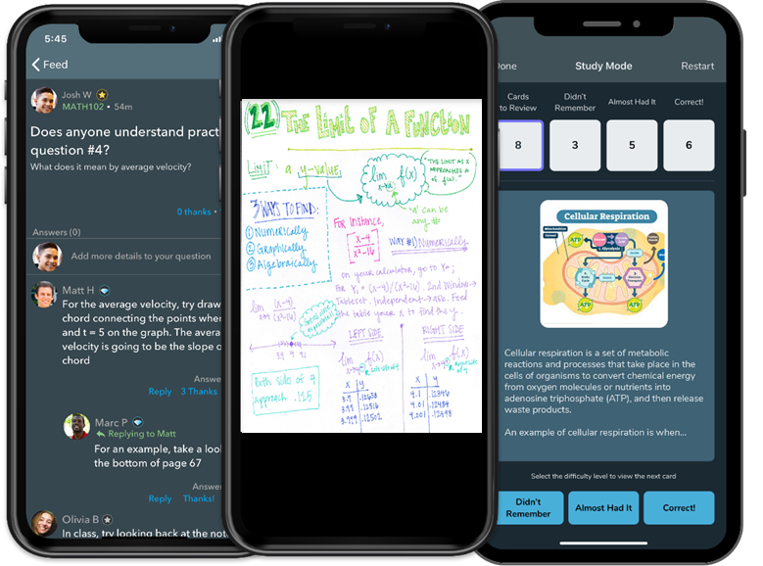
Peer led learning: Students leverage each other
Chat Rooms: Students interact with each other in a safe space.
Shared Notes: Upload a photo of handwritten class notes, or type in notes to share with the class.
Flashcards: Create study aids and study cards created by your classmates.
Anonymous Questions: No question is a stupid question.
Posts: Create text announcements or add formulas with LaTeX editor.
Resources: Attach videos from the internet, PDFs, URLs, or any type of attachment to be shared with everyone.
Notes:
[JAN]

Slide 7
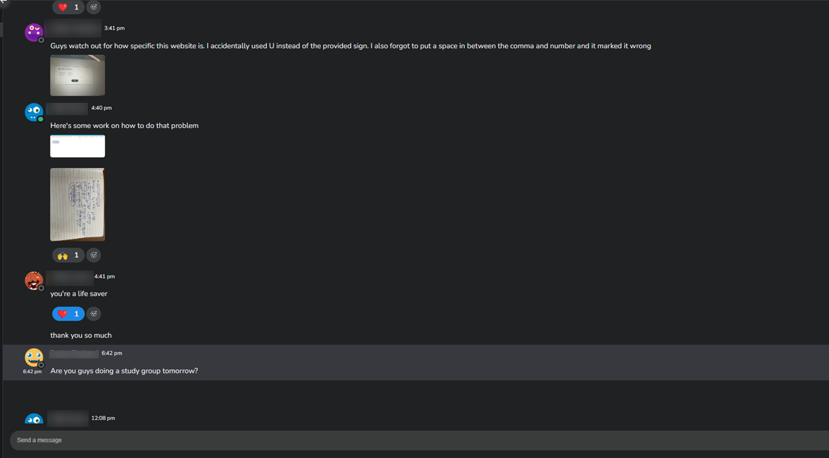
Students can warn each other about issues with technology, remind each other about due dates, post their own notes that may help others, and can explain topics in their own words.
Students thank each other with emojis and build a culture of gratitude.
Notes:
[JAN]

Slide 8

Course Feedback
Students are asked 4 questions:
  Did you accomplish your study goals this week?
  What did you learn during your class this week?
  Is there anything you’re struggling with or need help with?
  Do you have any questions you can’t find answers to or any unresolved needs in this class?
Notes:
[CHRIS]

Slide 9
accounting
Implementation -
  Promoted CircleIn during class, on syllabus, and via Blackboard postings
  Had SI leaders promote and use as well
  Required a limited number of study actions (1-5) and course feedback weekly
  Comprised a small percentage of overall grade (1-2%)
Current Semester (Fall 2024) -
  Added optional study groups organized through CircleIn
  Allowed 240 students to group themselves by available times into groups
  Group study can be done virtually through CircleIn or organized through group chat using CircleIn's messaging feature
2023-2024 Results -
  Student evaluations indicate the students enjoy the app and find it useful
  DFW rates decreased from previous semester
Notes:
[CHRIS]
Talk about changes that were made, lessons learned, etc.

Slide 10
nursing
1st semester using CircleIn
NUR216 – Pathophysiology Course
Used CircleIn’s implementation process
5 interactions per week for 10/16 weeks for “participation grade”
SI leaders use to develop SI sessions
4 sections, 130 – 155 students per section
Midterm evals in process
Notes:
[SUZANNE]
Talk about changes that were made, lessons learned, etc.

Slide 11
Math 141: Calculus I
Implementation -
  Promoted CircleIn during class, on syllabus, and via Blackboard postings
  Had SI leaders promote and use as well
Current Semester (Fall 2024) -
  Utilizing recitation GTAs to further encourage CI use
  Instructors required to report support to Student Success Center for early warning intervention
2023-2024 Results -
  DFW rates decreased from previous semester
Notes:
[LYDIA]
Talk about changes that were made, lessons learned, etc.

Slide 12
2023-2024 USC Pilot
Fall
87%
Student Engagement
6 sections
961 Students
ACCT225
MATH141
7 sections
358 Students
ACCT225
3 sections
668 Students
Spring
77%
Student Engagement
MATH141
5 sections
318 Students
CHEM333
1 section
230 Students
Notes:
This fall, we’ve worked with over 1300 students in 6 sections of Accounting and 7 sections of Calculus I; we had 7 faculty teaching these courses. We had 87% engagement in CircleIn.
Math 141 26.98% DFW
CHEM 333 28.6% DFW
ACCT 225 19.91% DFW
One instrumental person to this project is the supplemental instructor assigned by the Student Success Center – each section has an SSI assigned who is using Circle In as their primary means of communication.
Pilot continues in the spring with the addition of one section of Chem 333 – organic chemistry.
At the end of the semester, OIRAA will analyze the impact of this app on grade performance.

Slide 13
Study Actions across all sections (fall 2023/spring 2024)
Fall 2023 – ACCT 225, MATH 141
7,104 Flashcards created
3,292 Questions Asked
Spring 2024 - ACCT 225, MATH 141. CHEM 333
6,360 Flashcards created
5,236 Questions Asked

Slide 14
DFW Rate Improvements
Fall
Spring
Fall
Spring
Spring

Slide 15
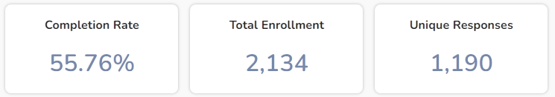
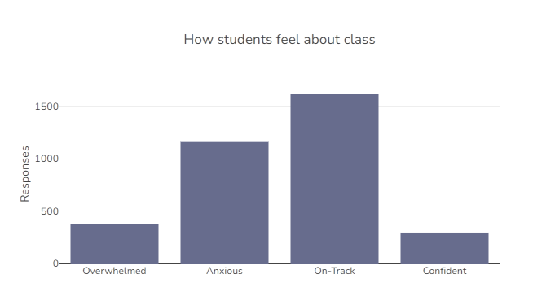
Course Feedback (Sept 2024)

Slide 16
Let’s chat
What strategies are you and your colleagues using in your classes to improve student learning?
Any questions?

Slide 17
Thank yoU!

