Slide 1
Flipped Classrooms serving as a scaffold for learning how to learn
Francis Marion Burns
University of South Carolina Salkehatchie
fmburns@mailbox.sc.edu

Slide 2
“The Pandemic Generation Goes to College. It Has Not Been Easy.”
Eliza Fawcett, New York Times, November 1, 2022. Online: https://www.nytimes.com/2022/11/01/us/covid-college-students.html
She quotes faculty, administrators, and students:
  Many more students are tentative and anxious.
  Lack foundational math skills and rigorous study habits.
Standards and grades declined in most academic areas

Slide 3
“The Elite College Students Who Can’t Read Books”
Rose Horowitch, Atlantic Monthly, November 1, 2024. Online: https://www.theatlantic.com/magazine/archive/2024/11/the-elite-college-students-who-cant-read-books/679945/
She interviewed 33 faculty and administrators in the humanities. Individual faculty members stated:
  Middle and high schools are not commonly assigning books for reading.
  Students “shut down” when confronted with ideas they don’t understand.
  Students have trouble staying focused while reading.
It’s not that students don’t want to do the reading. It’s that they don’t know how.

Slide 4
Meet students where they are at and provide a scaffold for learning skills
Be explicit in the skills needed for success
Provide resources for students to gain these skills
Hold students accountable for their performance
  Try to be flexible for students making progress

Slide 5
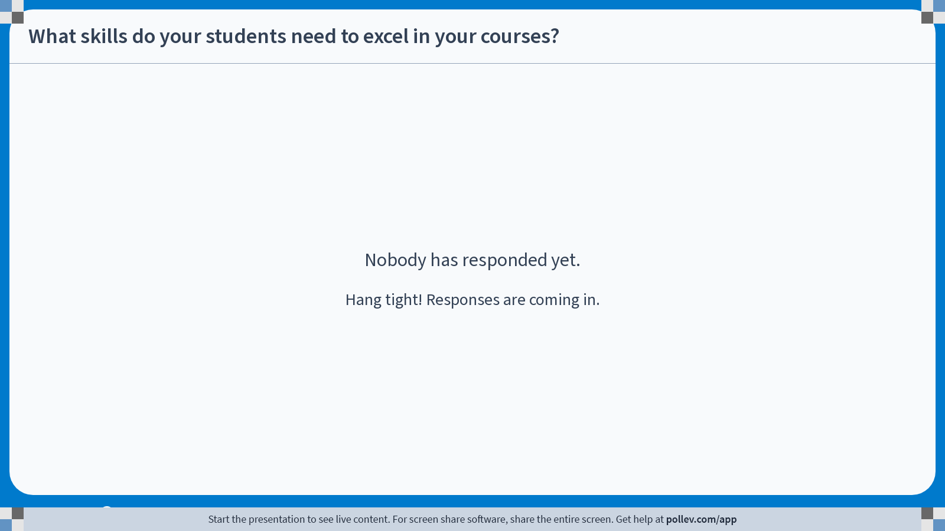
Notes:
Poll Title: Do not modify the notes in this section to avoid tampering with the Poll Everywhere activity.
More info at polleverywhere.com/support
What skills do your students need to excel in your courses?
https://www.polleverywhere.com/free_text_polls/FS2335lmtKVQUJmmQ05L0

Slide 6
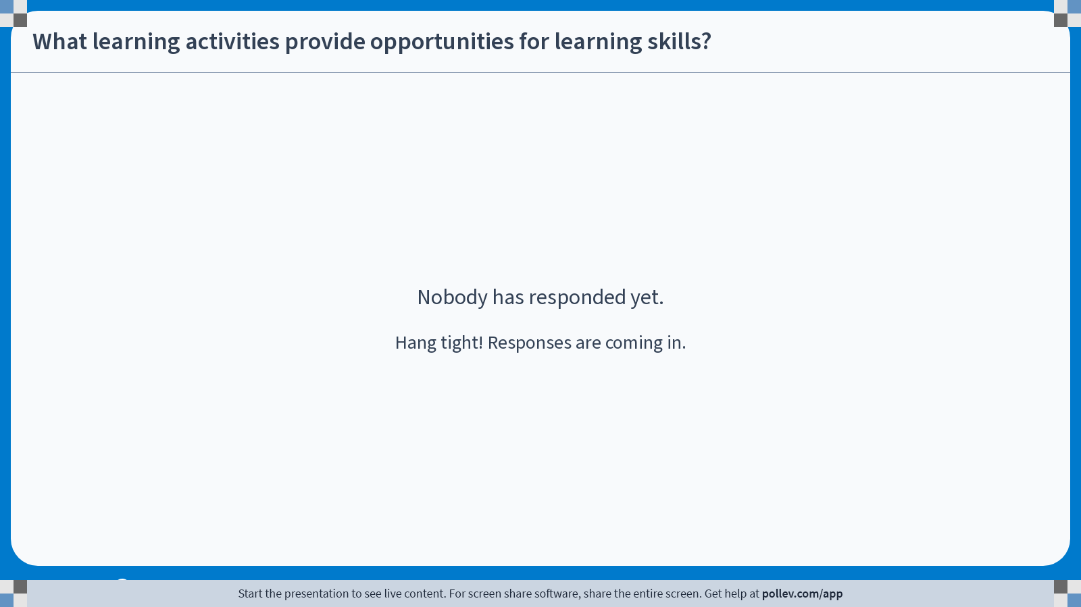
Notes:
Poll Title: Do not modify the notes in this section to avoid tampering with the Poll Everywhere activity.
More info at polleverywhere.com/support
What learning activities provide opportunities for learning skills?
https://www.polleverywhere.com/free_text_polls/fExyGL1lw9fHdvScSAks2

Slide 7
Flipped pedagogy for chemistry
Prior to classroom meetings, students are expected to complete the following pre-lecture activities (varies across courses):
  Watch online lecture videos: basic contents and skills with embedded formative assessment (VidGrid)
    I am assigning homework points for watching the videos.
  Read the chapter in textbook (average number of pages = 25 to 40 pages)
  Complete online content modules (ALEKS) corresponding to textbook chapters
    I encourage students to use targeted videos available through YouTube.com

Slide 8
Curriculum for chemistry
Classroom meetings focus on active learning:
  Summative assessment (quiz) occurs during the class session
  Question & answer period using classroom polling
    Students tended to ask me questions about assignments and assessments
    I tended to ask them questions about content
  Use lecture for “learning how to learn” activities, such as outlining a portion of a chapter (20 minutes)
  My questions draw heavily upon video and textbook content and end of chapter problems.
    I highlight the value of using these resources for learning chemistry

Slide 9
Curriculum for chemistry
Students are expected to complete these follow-up activities:
  Submit weekly journal entry
    Provides students with opportunities to reflect upon their learning
    Provides a private communication channel between students and their instructor

Slide 10
Curriculum for chemistry
Students have periodic summative assessments:
  Pre-test administered at the beginning of the semester
  Periodic semester tests
  Final examination consisting of (1) pretest and (2) randomly selected test questions.

Slide 11
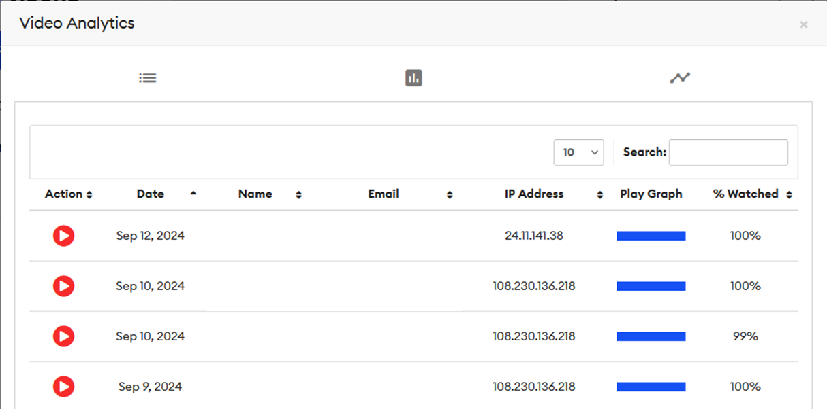
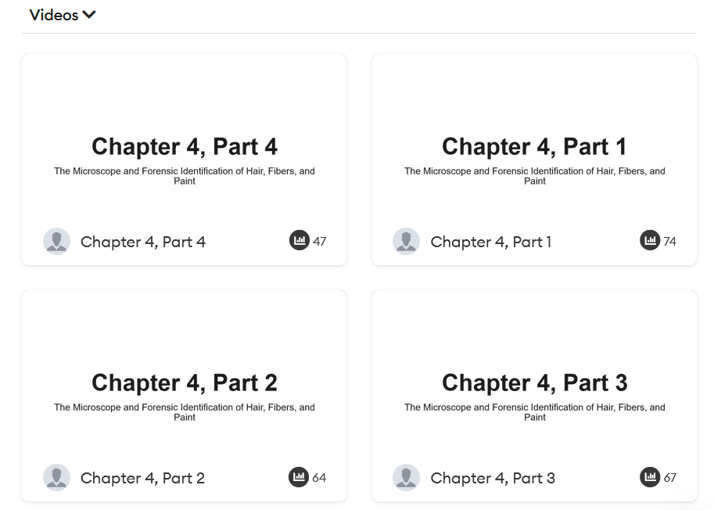
Accountability for students

Slide 12
Engagement Statistics
CHEM 107, Fall 2022 (N = 17)
CHEM 107, Fall 2024 (N = 4)
Goal = Provide students with timely feedback regarding their learning progress

Slide 13
Accountability for students
Short Chapter Quizzes (Summative Assessment)
  Different versions used by Burns
  Online quiz (prior to lecture coverage)
  Online quiz (after lecture coverage)
  In-class quiz (prior to lecture coverage)
  In-class quiz (after lecture coverage)
Goal = Provide students with timely feedback regarding their learning process

Slide 14
Accountability for students
Weekly Journal Entries
    Summarize your week’s work in chemistry & provide a ballpark estimate of total time spent on chemistry (in and out of class)
    Reflect on your week’s work. What are your gut feelings about the course? What problems and questions are you having?
    Plan the upcoming week. What assignments and assessments (quizzes or tests) will occur this week? When will you do them?
  Ideally, I score each entry within a few days after assignment deadline and provide a useful response.
    Sometimes, I am swamped with work…I inform students that communication can be slow via this asynchronous assignment.
    When I taught a lecture of 150 students, I scored journals 3-4 times/semester.

Slide 15
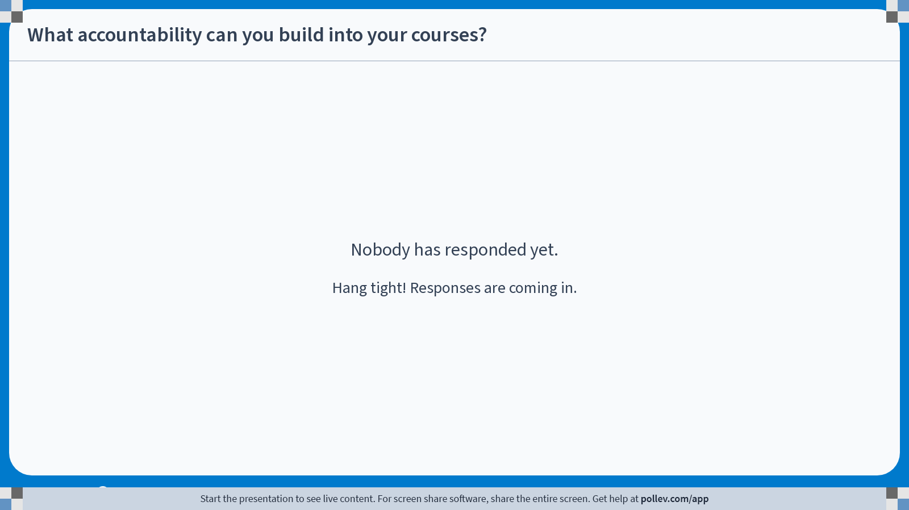
Notes:
Poll Title: Do not modify the notes in this section to avoid tampering with the Poll Everywhere activity.
More info at polleverywhere.com/support
What accountability can you build into your courses?
https://www.polleverywhere.com/free_text_polls/PJgOgzl2Mc2N8CFNwlPOG

Slide 16
Student feedback regarding flipped pedagogy
Students rarely like flipped pedagogy at the beginning of my courses.
  Many of my students are passive in their learning
  Flipped pedagogy demands students’ active participation
  They can be easily overwhelmed by active learning
My student evaluations have greatly improved as I pushed flipped pedagogy.
  My courses are more challenging, but most students recognize I am invested in their educational outcomes.
  I “sell” flipped pedagogy to my students
The first couple of weeks are very important for establishing expectations for the course.

Slide 17
Conclusions
Based upon my experiences in my chemistry courses, flipped classroom pedagogy emphasizes the active role that learners play.
Flipped classrooms provides time for active learning.
  Educational games
  Small group activites
  Q & A sessions using polling devices
Flipped classrooms offers opportunities for remedial activities:
  Effective notetaking skills
  Study skills
  Fundamental mathematics skills

Slide 18
Questions or Comments?

Slide 19
Acknowledgements
Innovative Pedagogy Grant from the Center for Teaching Excellence, University of South Carolina

