Slide 1
Two Easy Student Experience Project (SEP) Activities to Foster a Sense of Belonging in Your Course
Juan M. Caicedo
Civil and Environmental Engineering
caicedo@cec.sc.edu

Slide 2
Session outcomes
By the end of this session:
Describe the main idea behind the Student Experience Project (SEP)
Describe two SEP opportunities
Find additional resources about SEP

Slide 3
SEP
From the SEP First Day Toolkit

Slide 4
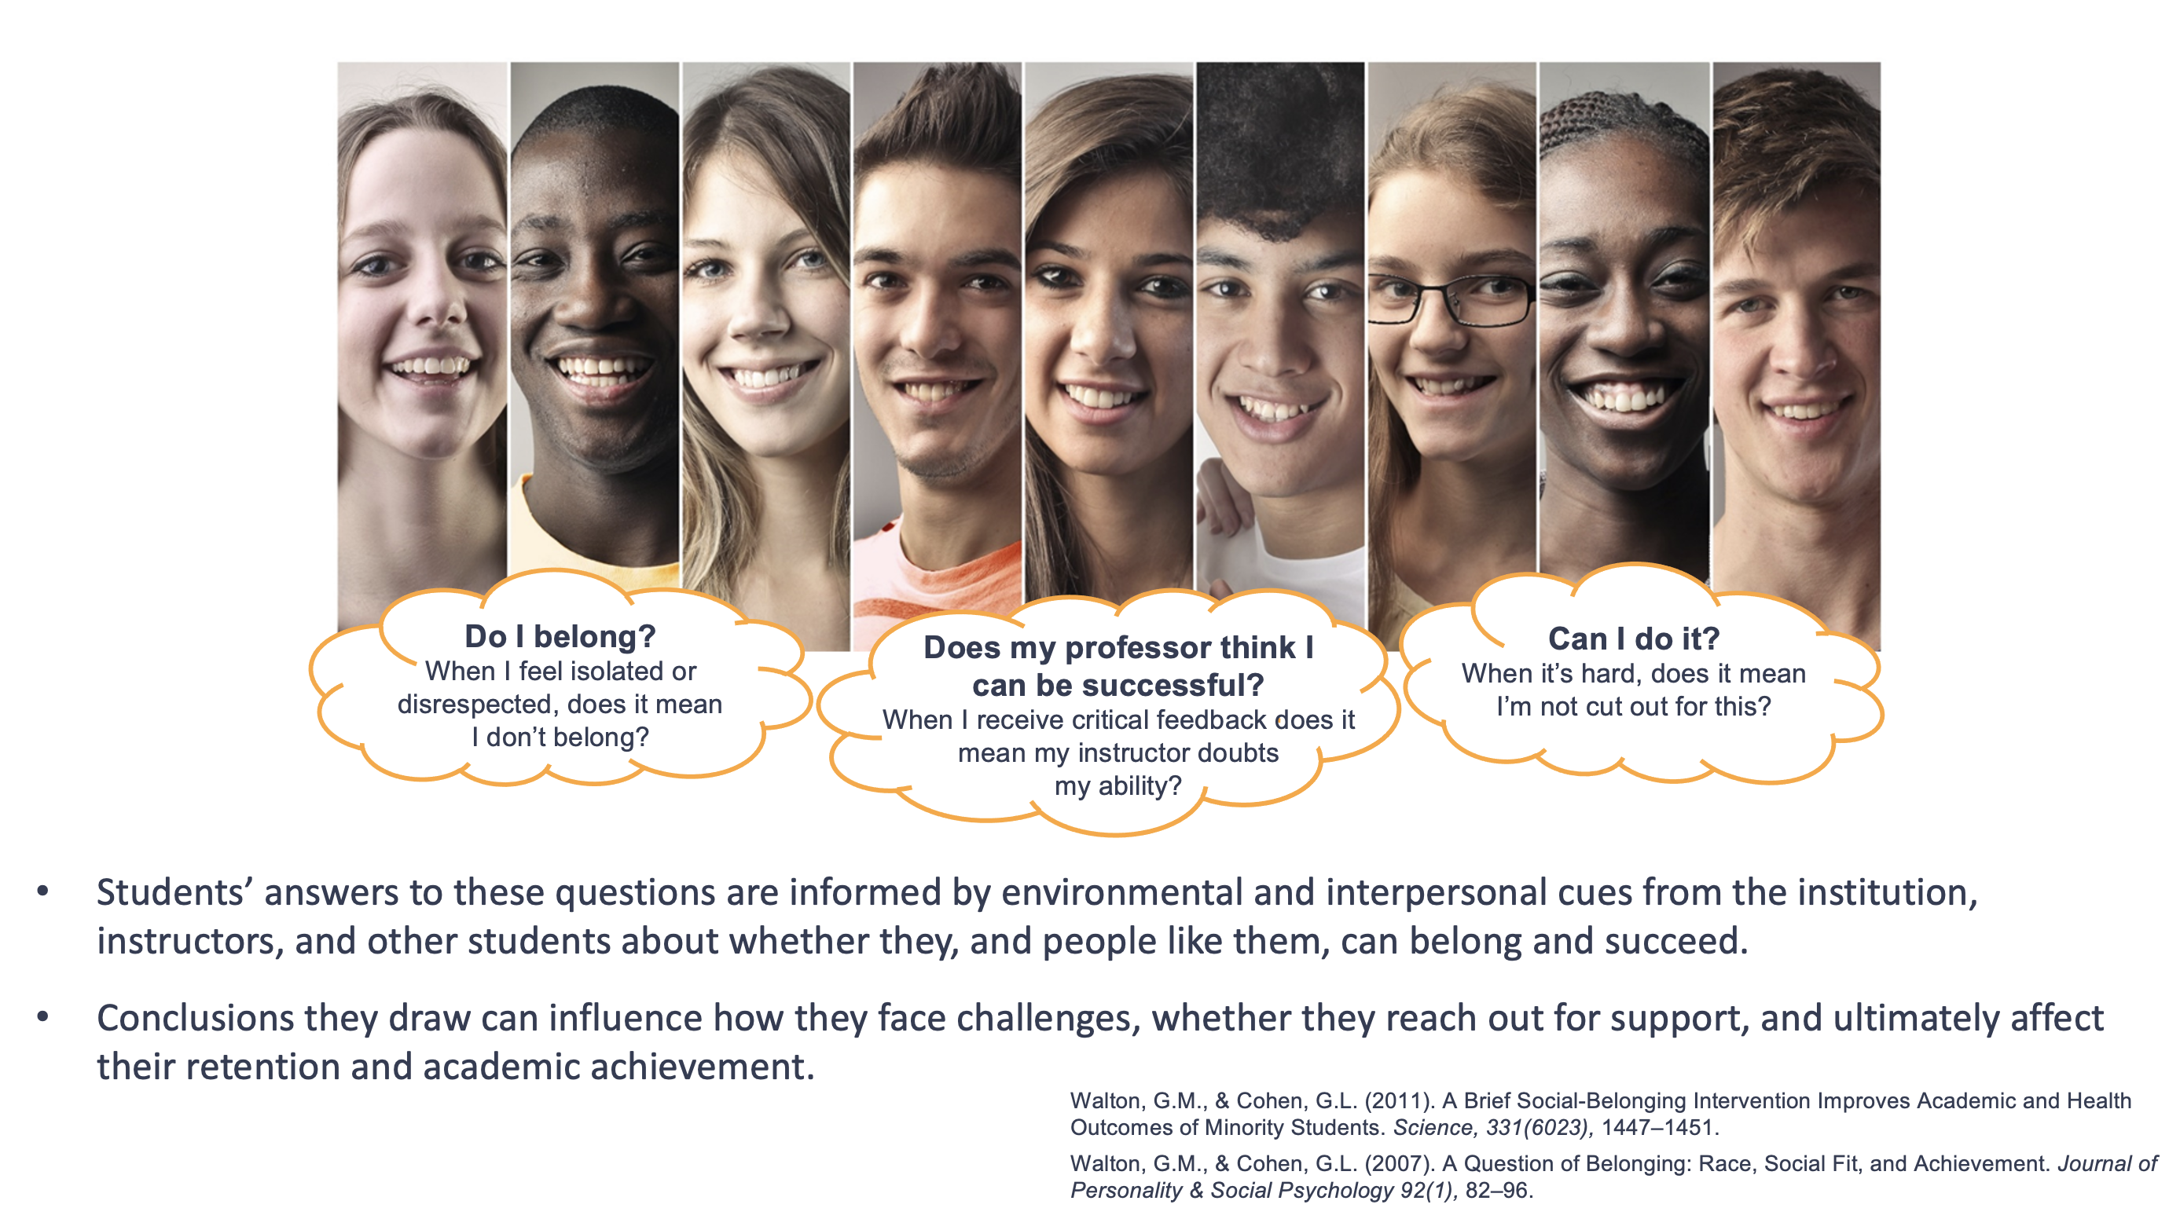
Notes:
The First Day Toolkit was developed through the Student Experience Project. The toolkit draws on decades of social psychology research have grounded the project’s understanding in how students navigate their college experience.
When students enter college, and at transitional moments throughout their college careers, students are asking themselves key questions about whether they belong and if they can succeed.
Their answers to these questions can determine how they face challenges that arise, whether they reach out for support, and ultimately affect their retention and academic achievement.
Environmental and interpersonal cues that signal one’s belonging and potential for success deeply impact students’ educational experiences, and the way they answer these questions. These cues often differ between groups and among individuals based on the local academic and social context, the stereotypes that are relevant to their group, and their group’s historical and continuing disadvantage.
Students from structurally disadvantaged groups come to campus knowing they will face underrepresentation, negative cultural stereotypes about their abilities, and other barriers. So they are paying particular attention to signals from the institution, their professors, and other students as to whether they, or people like them, belong on campus and can succeed there.

Slide 5
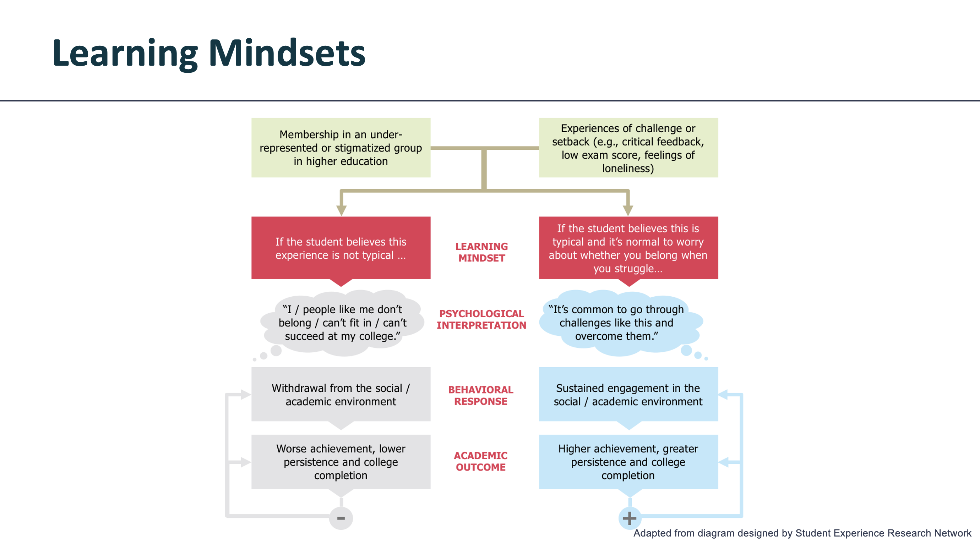
Notes:
When students run into challenges, like struggles with difficult course material or feeling intimidated by professors, and they think it is not typical to experience these things, it is understandable that they could take that as a sign that they don’t belong or can’t succeed.
Research shows that once students draw this conclusion, it can lead them to disengage academically (e.g. not going to professors’ office hours, not asking questions in class) and socially (e.g. not joining extracurriculars or study groups). This then affects their academic performance and retention, as you see on the left-hand side of the diagram.
If, however, students believe that it’s typical to face challenges in college, and they believe it’s possible to overcome those challenges, this leads to greater academic engagement and better academic outcomes, as you see on the right-hand side.

Slide 6
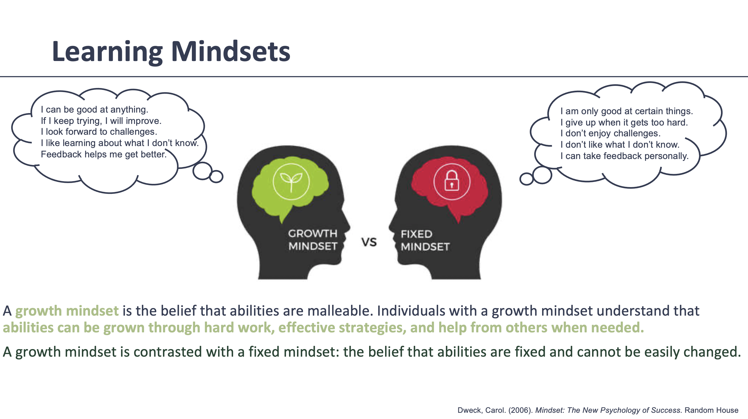
Notes:
Carol Dweck’s pioneering work on growth mindset helps us better understand how students navigate these questions.
Individuals with a growth mindset understand that abilities can be grown through hard work, the use of effective strategies, and help from others as needed.
Growth mindset is contrasted with fixed mindset – belief that intelligence is fixed trait, and either you have it or you don’t, and it’s set in stone, relatively speaking, at birth. When a student gets a poor grade or an assignment or test – if this student has a fixed mindset about intelligence, when they receive those poor grades they are likely to say “maybe I’m stupid at this. Maybe I’m just not a math person. I shouldn’t even bother trying.” This results in decreased effort as a behavioral response which in turn diminishes academic engagement and performance.
If, however the student has a growth mindset, and believes that intelligence and abilities can be grown and developed, they take the negative grade and think about it in different ways. Instead of taking it as a signal that they are stupid or not up to snuff when it comes to a particular field or area, instead they think “maybe I just haven’t mastered this yet. I need to work harder, or take a new approach or ask a question or go to office hours.” This results in an increase in effort and a use of positive learning strategies, which further increases students’ academic engagement and performance.

Slide 7
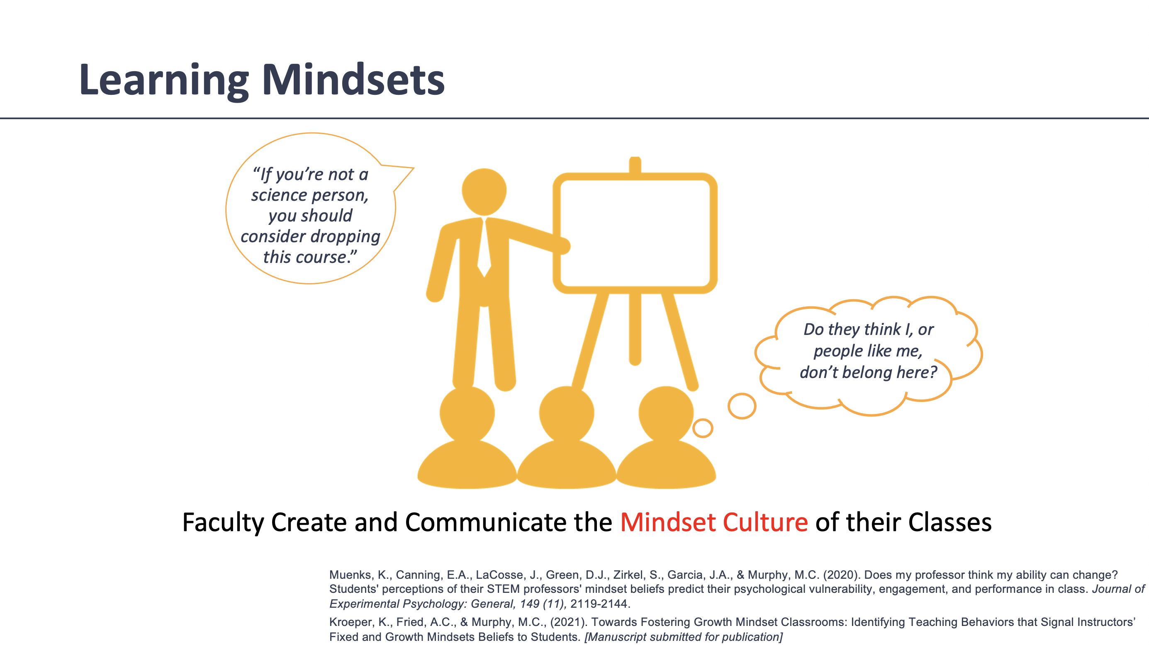
Notes:
More recent research has demonstrated that students’ perceptions of instructor mindsets influences how students feel about their abilities, and has a critical impact on students’ experiences and academic outcomes.
This is because even if our students believe they can learn and grow their abilities, our courses are not designed to let them do that, or we convey (accurately or not) that we believe some students just can’t cut it.
Then students may not be able to have a growth mindset, because they are learning in an environment that is not particularly conducive to growing their abilities.
For example, students frequently report that on the first day some instructors will emphasize the difficulty of classes by calling students attention to the high drop or failure rate of the course. They’ll say things like, “look to your left, look to your right, one of you won’t be here at the end of the term,” or, “if you’re not a science person, you should consider dropping this course. Often, the instructors’ intention in these instances is to motivate students into working hard and prioritizing the course. Unfortunately, the unintended consequence of this is that students perceive that the instructor really has a fixed mindset about students’ abilities.
Because students are aware of pervasive stereotypes by group membership, when they perceived their instructor to have a fixed mindset (i.e. believes abilities are fixed, can’t be easily changed) students can make inferences based on those stereotypes: EX: The instructor may expect men to have higher abilities than women; The instructor may expect White and Asian students to have higher abilities than Black, Latino, and Native American students.

Slide 8
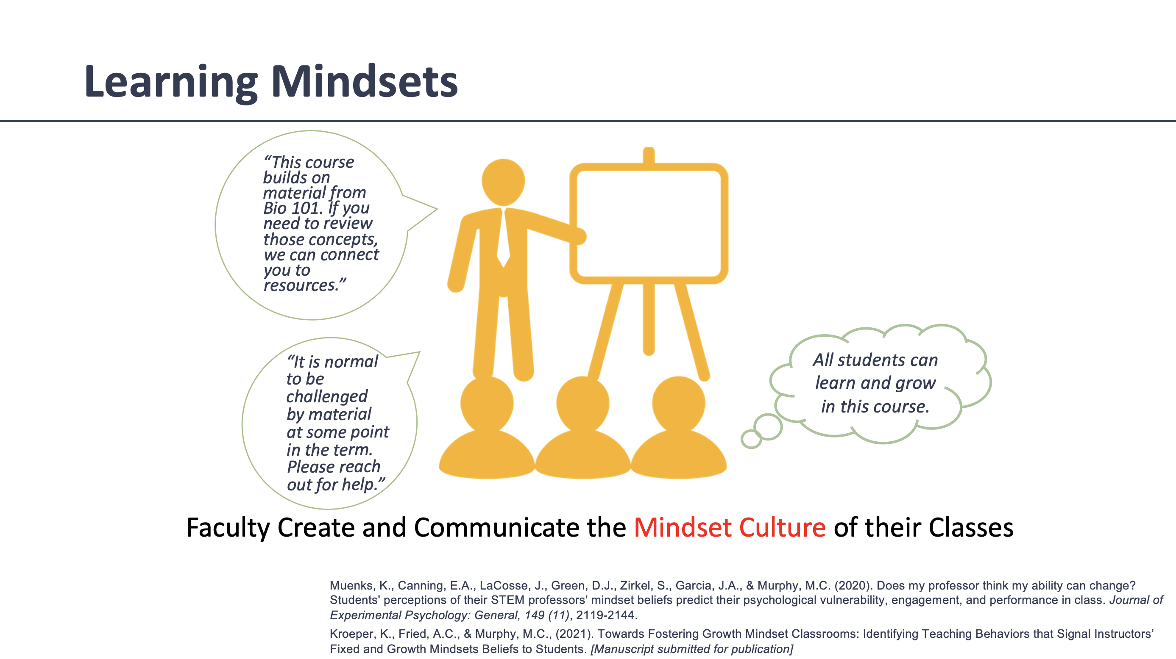
Notes:
Here, when an instructor says things like “This course builds on material from Bio 101. If you need to review those concepts, we can connect you to resources,” or “It is normal to be challenged by material at some point in the term. Please reach out for help.”, the instructor is setting the foundation and expectation that students’ abilities can grow, and students can perceive that the instructor has a growth mindset. Students can then infer that this instructor does not hold stereotypes about how different students will perform and engage in the course, and can assume that the instructor expects that all students are able to learn and grow their abilities.

Slide 9
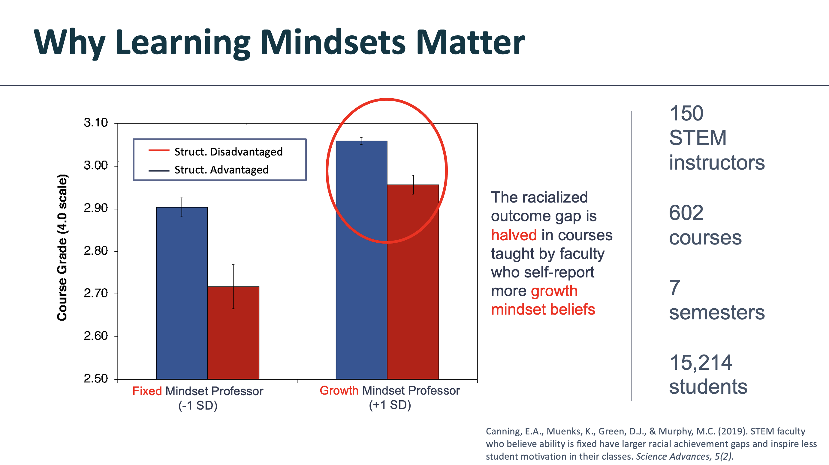
Notes:
Instructor mindset can impact student outcomes – this is one study that informs the resources in the First Day Toolkit. Here, the researchers had 150 STEM instructors at a selective public university participate in a survey measuring the degree to which they had a fixed mindset (i.e. believed that academic ability is fixed) or a growth mindset (i.e. believed that academic ability can grow with effort and strategies). They covered a total of 602 courses, over seven semesters, teaching a total of 15,214 students and looked at the relationship between the instructors’ mindsets and the performance of students in their classes.
They found that instructors who reported that they had more of a fixed mindset had a racial academic outcome disparity in their class that was more than twice as big as in courses taught by growth-mindset instructors.

Slide 10
It is not about low expectations
It is about high expectations with the appropriate learning environment

Slide 11
(Structured) Think Pair Share
Think
Read the syllabus
How do you rate this syllabus from 1(low) to 10 (high) based on your expectations of a good and complete syllabus?
Put yourself in the shoes of a 1 year, 1 semester student. How does the syllabus make you feel?

Slide 12
(Structured) Think Pair Share
Pair
There are two syllabi (A and B). Pair with someone that has a different type of syllabus to the one you have.
What are the differences in expectations? (e.g. how are grades calculated? Are the learning outcomes different? How about office hours?)
Compare the answer to the questions on the previous slide:
  Rating from 1(low) to 10 (high)
  How does the syllabus make you feel?

Slide 13
(Structured) Think Pair Share
Share
Any groups that would like to share?

Slide 14

Syllabus Module
Instructor: Dr. Christine Logel, Associate Professor, Social Development Studies (Renison University College)
Introduction to growth mindset and belonging
Short videos - core principles for a syllabus that supports student experience
Example syllabus with suggested language
Reflection questions and activities to help instructors apply principles to their own course
~ 90 minutes to complete
Notes:
The module was developed by Dr. Christine Logel, who is an Associate Professor of Social Development Studies at Renison University College, University of Waterloo.
The module starts with an overview of growth mindset and belonging, with examples of research studies that demonstrate the importance of these concepts for student success.
There are two example syllabi: one conveys that the faculty member has a fixed mindset, and the other conveys a growth mindset
A number of short videos highlight a few core principles to consider to create a syllabus to support equitable student experience.
For each core principle, the example syllabus will be updated to contain new language.
There are reflection questions throughout the module to help faculty incorporate that principle into the syllabus
This takes about 90 minutes to complete – it’s about 45 minutes of video content overall, plus some extra time to look through the example syllabi and respond to the reflection questions.

Slide 15
First Day Toolkit
Improving the messages and signals students receive on the first day of class to foster growth mindset, belonging and equity in student experience
Syllabus Revision Module
Syllabus Review Guide
First Day Practices
Workshop Facilitation Guide
A self-paced professional development opportunity with video lessons and example syllabi.
A step-by-step guide for creating a syllabus that promotes student equity, belonging, and growth.
Evidence-based guidance for setting equitable course policies and establishing expectations.
Suggested discussion prompts and activities for debriefing the syllabus review process.
Notes:
The first day of class is a critical point in time for students to perceive what the learning environment will be like. First Day Toolkit helps instructors create a growth mindset culture and convey that students belong in the course through messaging that students tend to receive on the first day of class – namely, the syllabus, and the way that instructors talk about course policies and expectations for engagement and performance.
The toolkit contains a self-paced online learning module, which has videos, example syllabi, reflection questions, and detailed revision guide, designed to help instructors to think about a variety of ways to create a supportive learning environment through their syllabus.
The toolkit also includes guidance for a couple of other core ways that faculty can support students on the first day of class, with step-by-step guides to help them implement these new practices.
Finally, there is a workshop facilitation guide to help leaders bring faculty together to discuss the revision process

Slide 16
Think Pair Share
Which professor are you more likely to ask questions about your exam?

Slide 17
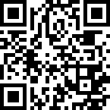
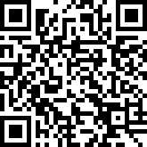
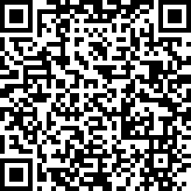
SEP project resources
Student Experience Project
https://studentexperienceproject.org/
Syllabus Module
https://library.studentexperienceproject.org/
courses/syllabus
Wise Feedback
https://studentexperienceproject.org/change_idea/
creating-a-wise-feedback-framing-statement/

Slide 18
Two Easy Student Experience Project (SEP) Activities to Foster a Sense of Belonging in Your Course
Juan M. Caicedo
Civil and Environmental Engineering
caicedo@cec.sc.edu

