Slide 1

Refining Peer Review Sessions to Enhance Student Engagement
Dr. Sarah E.S. Carter
Assistant Professor of English
University of South Carolina—Union
Notes:
Introductions

Slide 2

Peer Review as a Process
Traditional Peer Review doesn’t account for necessary student planning and preparation before and/or reflection after a peer review session.
Notes:
Speak on Traditional Peer Review Sessions– As we are all aware, unless prompted, students don’t typically prepare for peer-review sessions other than (maybe) printing off what is required to bring to the session, and often times, we don’t see that.

Slide 3

Preparing for Peer Review
Create worksheets for students to complete during the peer-review session.
Include both open and closed questions as well as objective and subjective questions.
Notes:
Some things we can do as teachers to help our students feel as though they are getting the most out of a peer-review session.

Slide 4


Introduce Pre-Reflection
Example Guiding Questions for Students before Peer-Review:
1. Why did you choose this topic/issue?
How does it align with your major?
2. Why did you choose this method of inquiry or research?
3. How do you work to support your claim (in this assignment)?
Aligning Questions to Assignment Purpose and Student Learning Outcomes
Notes:
Depending on how much time you have spent in class working in groups/pairs/together, some things may have already been discussed; however, by inviting students to fully reflect either by writing or recording themselves speaking, they can provide more substantial background on some of the choices, decisions, planning, organizing, and work they’ve done to have more fulfilling peer review sessions.

Slide 5


During
Peer Review
Ask students to use concrete language when responding to peer work and
Encourage students to use evidence from what they are reviewing to support their responses.
Notes:
Research shows us that

Slide 6

Introduce Post-Reflection
After Peer Review
Invite Student Reflection on the peer-review process and the feedback they received from their peer(s).
Invite Open-Responses.

Slide 7
Guiding Questions for Students to Reflect on the peer review session and their work
How was this peer review session different from previous experiences? (session specific question)
How did your peer respond to your specific needs/inquiries?(peer specific question)
What do you have left to work on/edit/revise after the peer review session? (writer specific question)
How are you planning to integrate some of the feedback you received? (writer specific question)

Slide 8
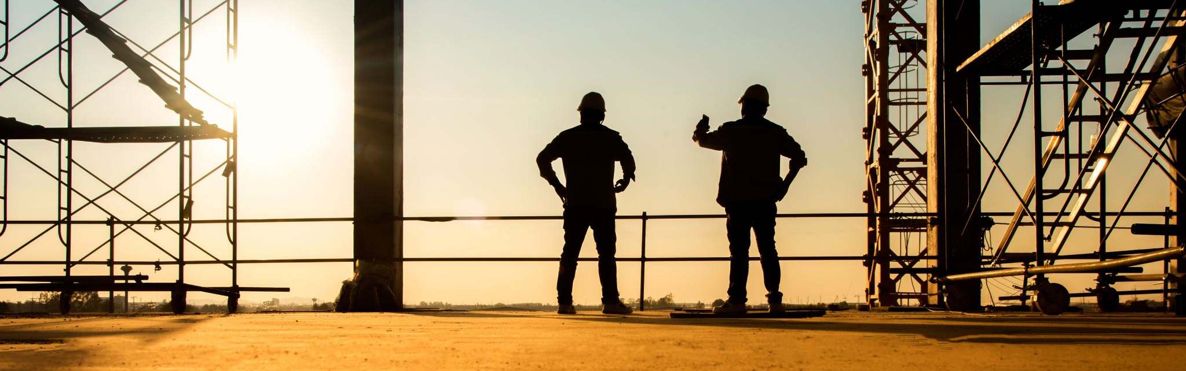
Refining Peer Review Sessions
-Main Takeaways-
Invite pre-reflection and post-reflection activities before and after peer review.
Offer opportunities for students to consider how their work aligns with the goals and objectives of the assignment and in relation to a larger context outside the academic classroom.
Encourage students to be honest and thoughtful about their purpose and intentions and learn to advocate for the choices they’ve made.

Slide 9
References and Resources
“Reflective Writing and The Revision Process: What Were You Thinking” Sandra L. Giles, Writing Spaces Textbook, 2010.
“Reflection is Critical for Writers’ Development” Kara Taczak, Naming What We Know, 2016.
”Responding—Really Responding-–to Other Students’ Writing” Richard Straub, The Subject is Writing, 1999.
“Listen to Others, Listen to Yourself: Combining Feedback Review and Reflection to Improve Iterative Design” Yu-Chun Grace Yen, Steven P. Dow, Elizabeth Gerber, Brian P. Bailey, 2017. https://dl.acm.org/doi/pdf/10.1145/3059454.3059468

Slide 10

Thank you!
Please stay in touch—
carterse@mailbox.sc.edu

