Slide 1
Integrating Creative Telehealth Simulations to Meet Advanced Practice Competencies
Leigh Pate, DNP, APRN, FNP-BC
Amy Dievendorf, DNP, APRN, FNP-BC, AGACNP-BC
Shelli Gibbs, DNP, APRN, FNP-BC
Robin Dawson, PhD, APRN, CPNP-PC, FAAN
Notes:
AMY
Good morning. We would like to welcome you to our presentation titled The Development of Integrating Creative Telehealth Simulations to Meet Advanced Practice Competencies

Slide 2
Learning Outcomes
Design telehealth simulation scenarios aligned with AACN competencies, allowing students to actively engage in virtual learning experiences.
Map telehealth scenarios to specific nursing competencies, ensuring alignment with program objectives.
Utilize feedback mechanisms such as SP reflections and SOAP notes to assess and improve student competency development.
Notes:
AMY

Slide 3
Meet the Team
Dr. Amy Dievendorf: CO-PI
Dr. Shelli Gibbs: CO-PI
Dr. Leigh Pate: Co-I
Dr. Robin Dawson: CO-I
Notes:
Amy
Let’s introduce you to our team. I am Dr. Leigh Pate and serve as a Co-Investigator. I am an Associate Professor, board-certified FNP who utilizes telehealth in school-based centers and rural underserved populations. And I have Dr. Amy Dievendorf with me who is an associate professor here at the college and program director of the AGACNP program and has over 14 years experience as an Acute Care Nurse practitioner. She serves as the Co-PI on our grant along with
Dr. Shelli Gibbs who is an Associate Professor and Director of the FNP program here at the CON. She has 8 years of experience as a nurse practitioner providing primary care. We also have Dr. Robin Dawson, Co-Invesitgator. Associate Professor and Interim Associate Dean for Academics and Accreditation. She is a board-certified pediatric practitioner. Her current research focuses on the use of telehealth to facilitate the completion of at-home screening modalities among rural, minoritized populations.

Slide 4
Advisory board
Brandon Boyd, APRN, FNP-C
Tara Smalls, DNP, APRN, FNP-C, PMHNP-C
Hannah Collins, DNP-FNP Student
Katherine Jacobs, BSN Honors Student
Notes:
AMY
In addition to ourselves, our team is also comprised of an ad hoc committee consisting of 2 practice partner preceptors who work in telehealth delivery in their every day practice, a current NP DNP student, and a prelicensure honors student.
Brandon Boyd APRN, FNP-C
Lexington Medical Center
Columbia Medical Group
Internal Medicine, Columbia, SC
Tara Smalls DNP, APRN, FNP-C, PMHNP-C
Oasis Physical Medicine
Columbia/Orangeburg, SC
Prisma Health
Community Health/Mobil Unit
Hannah Collins- DNP-FNP Student
Katherine Jacobs- BSN Honor Student

Slide 5
Standards
Commission on Collegiate Nursing Education (CCNE Accreditation)
NONPF National Task Force (NTF) Standards
AACN Essentials
Specialty Standards
Notes:
AMY
As a nurse practitioner program, we have many different standards we abide by. these standards form the basis of which we teach and how we build our curriculum.
CCNE is our accrediting body
Standards for quality nurse practitioner education- a report of the National Task Force on Quality nurse practitioner education (nonpf and aacn)
delineates national standards for the development and assessment of NP programs.
And multiple standards for our various NP specialty tracks, including Adult Gero Acute care, Family, and Psych mental health.
I’m sure each of your educational disciplines have standards and accrediting bodies that you need to consider when incorporating telehealth and virtual scenarios into your teaching plans. I’d encourage you to think about those bodies as we discuss our presentation today.

Slide 6

Asynchronous online learning
Notes:
AMY
Many of our courses with the CON, are delivered as asynchronous coupled with in-person immersions on campus. Given the current lifestyle and demographics of our students, it is challenging to require them to visit our campus often so we had to be creative to enhance our abilities to work directly with them in a controlled learning environment.

Slide 7

What is cbe?
“A system of instruction, assessment, feedback, self-reflection, and academic reporting that is based on students demonstrating that they have learned the knowledge, attitudes, motivations, self-perceptions, and skills expected of them as they progress through their education.” (AACN, 2021)
Notes:
AMY
So what is CBE? AACN defines it as “A system of instruction, assessment, feedback, self-reflection, and academic reporting that is based on students demonstrating that they have learned the knowledge, attitudes, motivations, self-perceptions, and skills expected of them as they progress through their education”
The key here is that it is based on students DEMONSTRATION of a learned task.
In CBE, students are the center of the learning experience and Performance expectations are clear.

Slide 8

The challenge
Curriculum mapping
Detailed look into course and program objectives
Community Partner Input
Notes:
AMY
So, as you can imagine, this drastic shift in the way we have always done things, to a more competency-based education posed a challenge. How do we adjust our current curriculum to meet the requirements of the new competency based education and assessment? Well fortunately, our curriculum is in a good place to start with. We begin by creating a very detailed mapping grid to be able to see our course objectives and where they align with the new competencies and subcompetencies. We were then able to clearly see any holes, or places we currently aren’t meeting that are required guidelines. In addition, we were able to listen to our community partners regarding readiness for practice upon graduation. This included improving critical thinking skills, communication, physical exam findings and documentation.

Slide 9

solutions
Simulation
Clinical Experiences
On-Campus Immersions
Notes:
AMY
What can we do about it? We can look at the competencies or subcompetencies we currently aren’t meeting and create assignments or projects related to them, but one of the easiest ways to demonstrate a competency, is to actually see the students in action! While a majority of this is done in the clinical setting, there are some things we as faculty members need to directly observe from our students . And remember, this isn’t just a one and done. The whole point of competency based education is to provide repetition of these skills, and the opportunity for the student to practice multiple times so that we can truly deem them “competent”.
On campus immersions are one option. We currently bring the FNP students to campus for 3 total on campus immersions, each an average of 3 days long, and our AGACNP students come to campus for two immersions. However, we are an online program, so further adding more required on campus immersions just isn’t feasible. It’s an increased cost to students as well as a significant time expenditure.

Slide 10
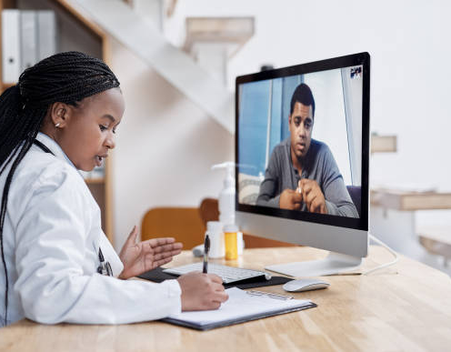
Why Telehealth?
Demonstration of competencies without increasing required on-campus time
Perform full physical exam on SP
Increased opportunities to assess practice readiness
Notes:
AMY
Simulation is one of the best ways to demonstrate competencies in a safe and standardized setting. Increasing time spent on campus is ideal, but not practice due to the online asynchronous nature of our programs. This is an innovative way to check off multiple demonstrations of competencies in an efficient and accurate manner while considering student needs and challenges. Telehealth simulation will provide us with a unique and innovative solution to fill in some of the gaps in our mapping. Faculty can create diverse types of telehealth scenarios to meet multiple domains, competencies, and subcompetencies required in The Essentials.
Increase real- life simulation scenarios in a virtual environment
State the purpose- straight from the grant- The purpose of the is project is to expand the telehealth experience of students by adding peripheral devices to patient scenarios to meet the new advanced level nursing educational competencies

Slide 11
Methods
This project adds peripherals to augment existing telehealth scenarios
Allows the APRN student to perform a full physical exam on an SP
Creates numerous opportunities to incorporate virtual simulation into multiple touch points through the curriculum.
Notes:
AMY
Will create more robust simulation opportunities.
Discuss how much we were awarded for the grant: Awarded approximately 21,000, which included Laptops, Peripherals, Standardized patients, travel

Slide 12
Steps
Development of Objectives, Outcomes & Scenario
Meet with Advisory Board
Didactic Training Begins
Scenario review
& SAEL planning
Telehealth Simulation
Notes:
AMY
Backwards design- talk about our outcomes; determine evidence, then learning activity.
The team met to develop scenarios and reviewed curriculum mapping and competencies. An ad-hoc advisory committee was formed, which consisted of a UG student, an FNP student, and 2 NP in the community who were knowledgeable and experienced in telehealth. The advisory committee's purpose was to consider the student perspective in all project activities and ensure using current and practical clinical scenarios.
Adding the addition of peripherals allowed faculty to develop real work simulations for the students, enhanced knowledge uptake and familiarity with technological devices they are likely to use in future practice.

Slide 13

Any Questions so far?
Notes:
AMY

Slide 14

Scenario
FNP students engaged with a standardized patient physically located in a rurally located primary care clinic via telehealth.
The FNP student conducted a full exam using the peripherals.
There were 2 Chief complaints:
  Facial Pain: This one did not require a referral
  Abdominal Pain: Required referral to the AGACNP on call for the ER.
Abdominal Pain Chief Compliant: Once the AGACNP student received a report from the FNP student, the AGACNP student performed a full exam and provided orders for the next steps.
Notes:
LEIGH
Discuss the scenarios

Slide 15
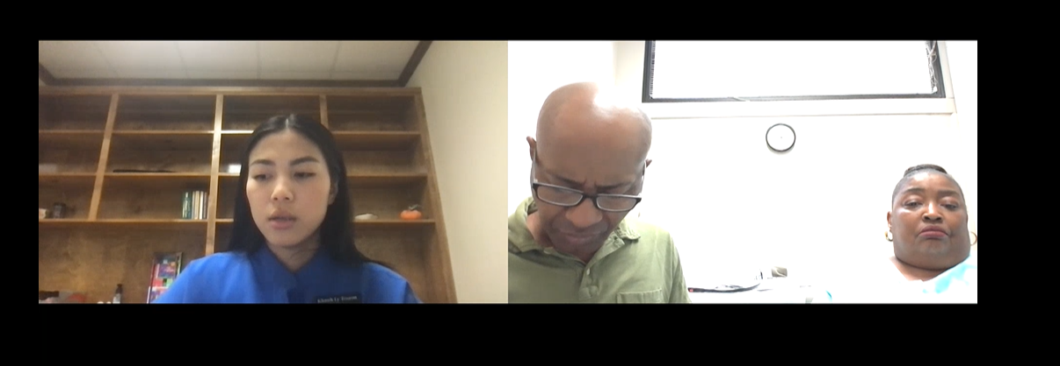
Image of the Telehealth Room
Notes:
Leigh: Explain the Room

Slide 16
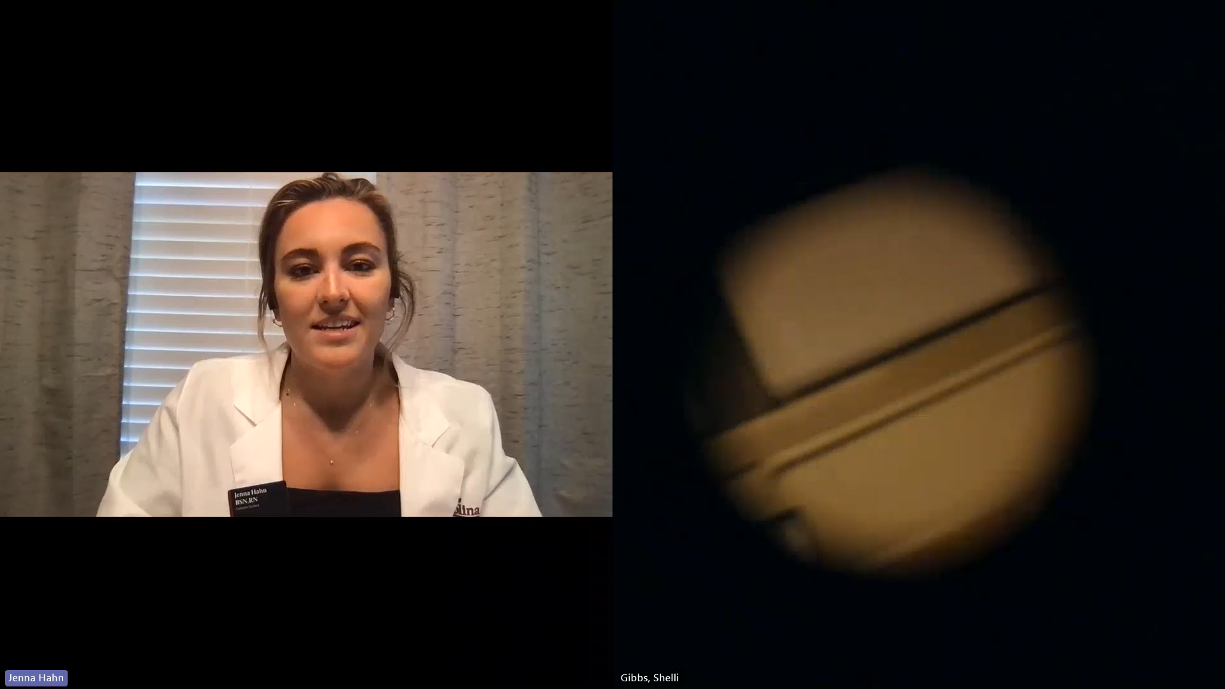
Example Video using the otoscope
Notes:
Leigh: Provide The Video

Slide 17

Outcomes and evaluation process
SP and faculty feedback
Pre and post-knowledge surveys and confidence surveys
Notes:
Leigh: Methods of evaluation

Slide 18
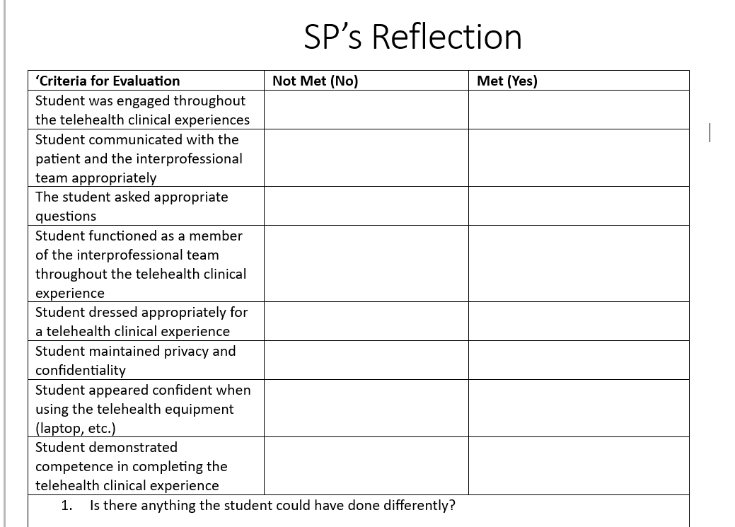
SP Rubric to Provide Feedback
Notes:
Leigh: Will review the process for the SP Reflection

Slide 19
Faculty Rubric To Provide Feedback
https://telehealtheducation-ctier.com/wp-content/uploads/Attachment-I-Simulation-Checklist.pdf
Notes:
Leigh: Link to the faculty rubric: NONPF

Slide 20
Question 1
Notes:
Leigh:For Question 1, we asked how competent do you feel in demonstrating appropriate telehealth etiquette, professionalism, and communication with a virutal patient pre and post. Results noted significant increase in competence after completing the virtual encounter.

Slide 21
Question 2
Notes:
Leigh:Question 2- How competent do you feel conducting a physical exam on a virtual patient using telehealth peripherals? large improvements with many students moving to moderately high level of compentence after the experience.

Slide 22
Question 3
Notes:
Leigh:Question 3- how competent do you feel assessing the history of present illness and review of systems specific to the presenting complaint with a virtual patient? We saw increase in number of moderate competence along with some reporting high level of competence.

Slide 23
Question 4
Notes:
Leigh:Question 4- How competent do you feel in demonstrating appropriate provider to provider hadn off communication? Students who rated themselves as average pre-experience moved to moderately high or high level of competence post experience.

Slide 24
Question 5
Notes:
Leigh:Question 5- How competent do you feel in utilizing appropriate communication when working with intraprofessional teams? Most average pre experience students increased from average to moderately high or even noted high competence.

Slide 25
Qualitative Feedback: Students
"Eye opening experience.... I need to work on my instrcution to the medical personnel …. and im,prove upon my format of the visit. "
"...Organizing my review of systems and obtaining pertinent positives and negatives as if in the clinic really helped me stay on track. It was an adjustment to not being able to perform the assessment myself. I think I missed out on some things not being able to do hands-on. The peripherals were a nice additive, but sometimes it was hard to hear. I enjoyed the experience. It was a great learning opportunity in a safe space."
I thought the assignment was great practice in talking with patients virtually! It is definitely more difficult than seeing patients in person, but I believe telehealth can be a great resource in the future. I would love to have competence in seeing patients virtually.
Notes:
Leigh:The student found their first telehealth experience as a provider eye-opening, gaining insights into assessments, history-taking, and using peripherals. They acknowledged areas for improvement, particularly in guiding medical personnel during exams and following a more methodical approach (Subjective, Objective, Assessment, Plan). Although adjusting to not performing hands-on assessments was challenging, organizing the review of systems helped maintain focus. Despite some issues with peripherals, they found the experience valuable and enjoyed practicing virtual patient interactions. The student believes telehealth is more difficult than in-person care but sees its potential and wants to improve their competence in virtual care.

Slide 26

Framework to Expand beyond nursing
Customize Telehealth Scenarios
Interdisciplinary Collaboration
Use Standardized Patients/Models
Integrate Virtual Tools & Technology
Develop Competency-Based Objectives
Notes:
Leigh:
Customize Telehealth Scenarios:
Design discipline-specific virtual simulations (e.g., psychology, sports medicine, business).
Adapt cases to reflect common real-world challenges in each field.
Interdisciplinary Collaboration:
Involve faculty from other disciplines to create realistic simulations.
Encourage cross-discipline teamwork and communication in virtual environments.
Use Standardized Patients/Models:
Implement standardized patients (actors) for disciplines like counseling, social work, or sports therapy.
Modify the models to provide real-time feedback on skills specific to each profession.
Integrate Virtual Tools & Technology:
Utilize peripherals or virtual tools relevant to the discipline (e.g., diagnostic tools for healthcare, virtual whiteboards for education, financial software for business).
Ensure the technology supports discipline-specific assessments.
Develop Competency-Based Objectives:
Create learning outcomes aligned with discipline-specific competencies.
Map these competencies to the simulation experience, ensuring alignment with program goals.

Slide 27
Framework to Expand beyond nursing
Promote Critical Thinking & Problem Solving
Feedback Mechanisms
Expand to Graduate & Undergraduate Levels
Incorporate Real-Time Interaction
Flexible Learning Modalities
ThePhoto by PhotoAuthor is licensed under CCYYSA.
Notes:
Leigh:
Promote Critical Thinking & Problem Solving:
Include complex scenarios that require critical decision-making and analysis.
Encourage students to engage with real-time problem-solving, mimicking real-world challenges.
Feedback Mechanisms:
Use discipline-appropriate rubrics, reflections, or evaluations (e.g., SOAP notes in healthcare, case analyses in business).
Offer constructive feedback based on the student's performance in virtual simulations.
Expand to Graduate & Undergraduate Levels:
Apply simulations at both graduate and undergraduate levels, adjusting complexity according to academic level.
Incorporate Real-Time Interaction:
Enable real-time feedback and interaction during the simulation for immediate learning opportunities, applicable across various fields.
Flexible Learning Modalities:
Adapt virtual simulations for both synchronous and asynchronous learning environments, making them suitable for online education programs in diverse disciplines.

Slide 28
References
American Association of Colleges of Nursing (2021). The Essentials: Core Competencies for Professional Nursing Education. AACN
American Association of Colleges of Nursing (2023). Guiding Principles for competency-based education and assessment. AACN
Center for Telehealth Innovation Education Research (2020-2024). Retrieved from https://telehealtheducation-ctier.com/national-telehealth-toolkit-for-educators/
Gibson, N., Arends, R., Voss, J., Marckstadt, S., & Nissen, M. (2020). Reinforcing Telehealth Competence Through Nurse Practitioner Student Clinical Experiences. Journal of Nursing Education, 59, (7). doi:10.3928/01484834-20200617-12
Wamsley, M., Cornejo, L., Kryzhanovskaya, I., Lin, B. W., Sullivan, J., Yoder, J., & Ziv, T. (2021). Best practices for integrating medical students into telehealth visits. Journal of Medical Internet Research Medical Education, 7(2), e27877. https://doi.org/10.2196/27877
Notes:
Leigh

Slide 29
Any Questions?
Notes:
Leigh--- What questions do you have?
Let's brainstorm together:
-What scenarios could you create in your own teaching discipline to evaluate your students?
-Would you need a standardized patient/student/client?
-What feedback would you be looking for?
-Could you use Zoom and/or Teams for your platform of recording?
-What would be your learning outcomes for the experience?

Slide 30
Thank You!
Dr. Pate (LBPate9@mailbox.sc.edu)
Dr. Dievendorf (adievend@sc.edu).

