Slide 1
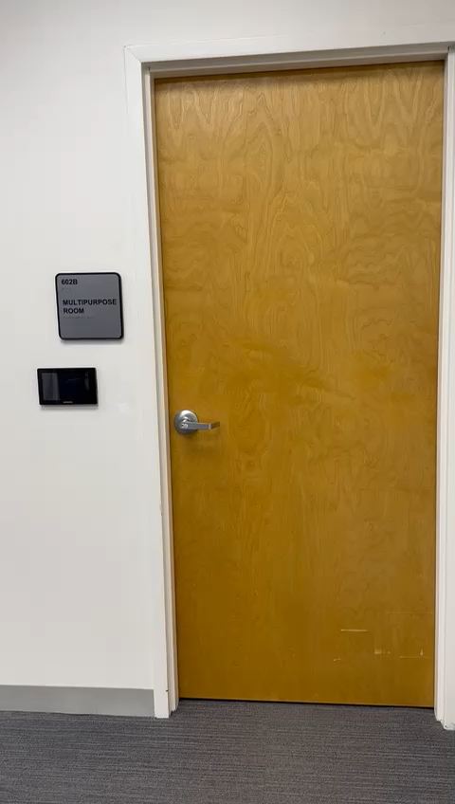
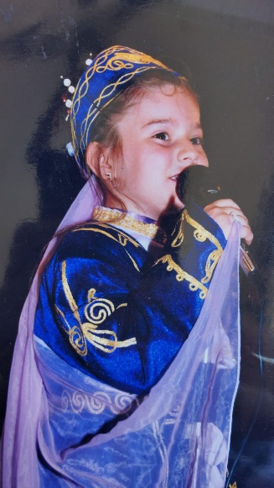
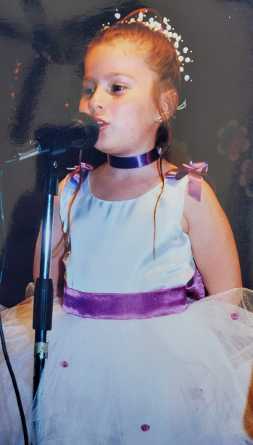

Slide 2
Wake Up and Tune In: Using Music to Energize Early Classes
Damla Sonmez
Ph.D. Student & Instructor
Hospitality Management

Slide 3
Why You Will Hear Music When You Enter the Classroom?
Create a Welcoming Atmosphere: At this early hour, I want to ensure you don't walk into a silent, sunless room. Music will create a more inviting and energetic atmosphere.
Wake-Up Call: A lively tune can help shake off the morning grogginess and get you ready to learn.

Slide 4
Why We Will Start Our Class with a Music Activity That Is Not Related to Our Course Content?
Enhance Listening Skills: Listening is a crucial skill for our class. during the lesson.
Improve Concentration: Music activities can enhance your concentration and attention to detail.
Brain Exercise: Each activity will be different, providing a unique challenge to stimulate your brain and keep you engaged.
Encourage Creativity: These activities will spark your creativity and encourage you to think outside the box.
Attendance: These activities will also serve as a way to take attendance in a fun and interactive manner.
Build Routine: Establishing a routine with music can help you transition smoothly into the academic content.
Flexible Start: By starting with music, even if you arrive a few minutes late, you won't miss critical course content. You can still participate in the activity.

Slide 5
Why I will Always Play Turkish Music?
Cultural Sensitivity: As Turkish is my first language, I can ensure the lyrics do not contain any sensitive content.
Cultural Exposure: I want to broaden your cultural knowledge and introduce you to the richness of Turkish music. Plus, providing an authentic cultural experience that you might not encounter elsewhere.
Global Perspective: Understanding and appreciating different cultures will expand your global perspective.
Unique Activities: If I played English songs that you already know, it would diminish the challenge of some activities, especially those focusing on guessing and interpretation. In addition, listening to something unfamiliar can be more engaging and thought-provoking.

Slide 6

And finally... You should feel lucky that at least I am not the one singing just to keep you awake. Or maybe, if you are lucky enough, one day I will sing only for you.

Slide 7
Rules
The activity will take no more than 4 minutes of the class.
It will not be graded.
Participation in this activity will count as attendance.
The activity will begin with a creative question (drawing) and end with a short answer question.
The winner of the day will receive their favorite drink during the next class.
Even for the short answer question, which has a correct answer, I am more interested in the reasoning behind their answer. How they explain their choice is more important than simply picking the right answer.
So, anyone can win any day…

Slide 8

Are you ready?

Slide 9
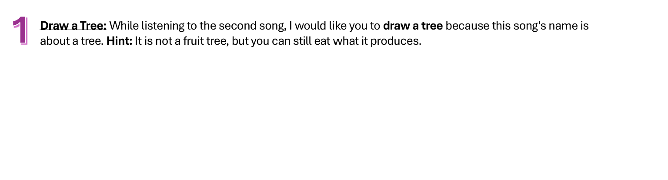

Slide 10
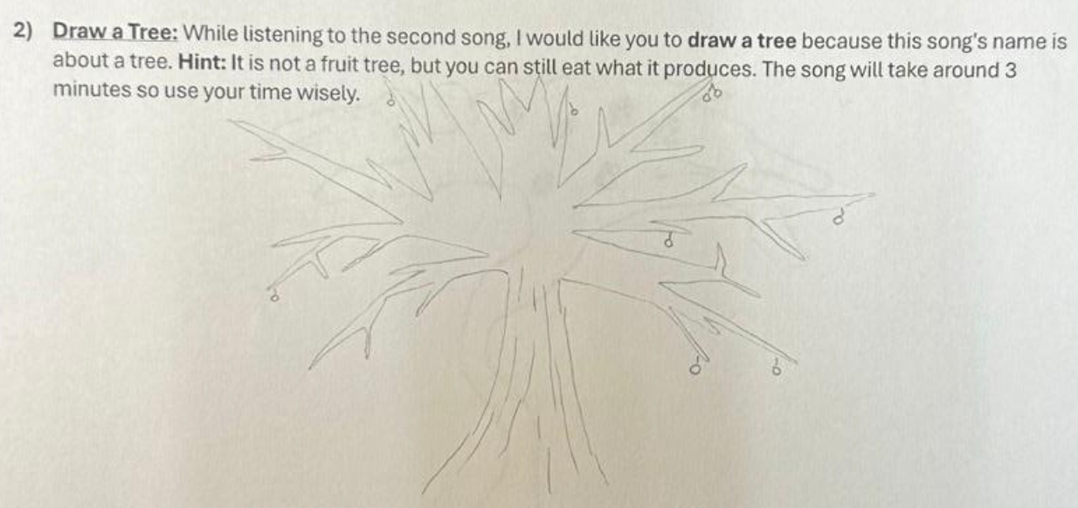


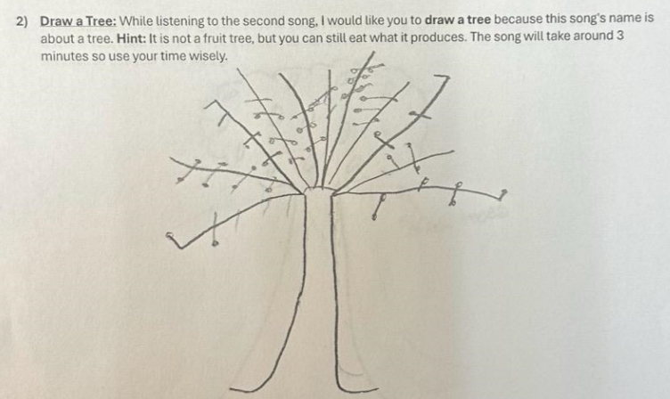

Slide 12
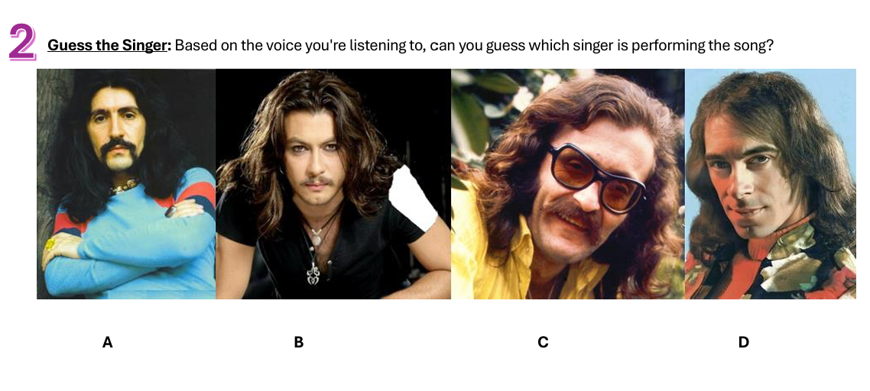

Slide 14
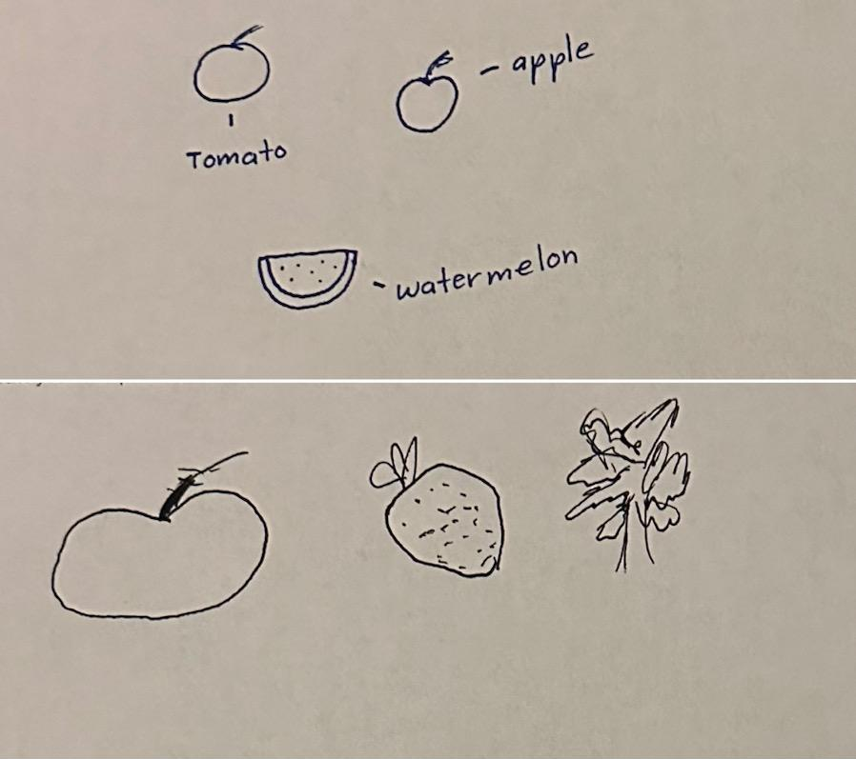
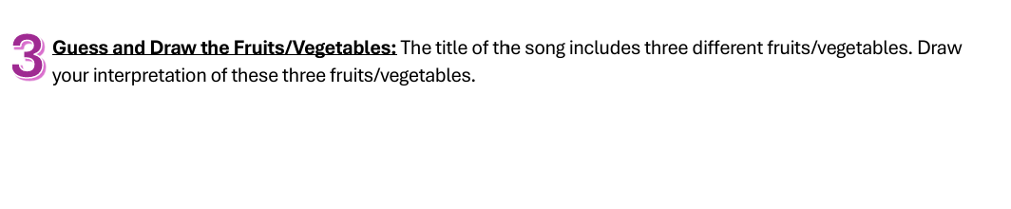
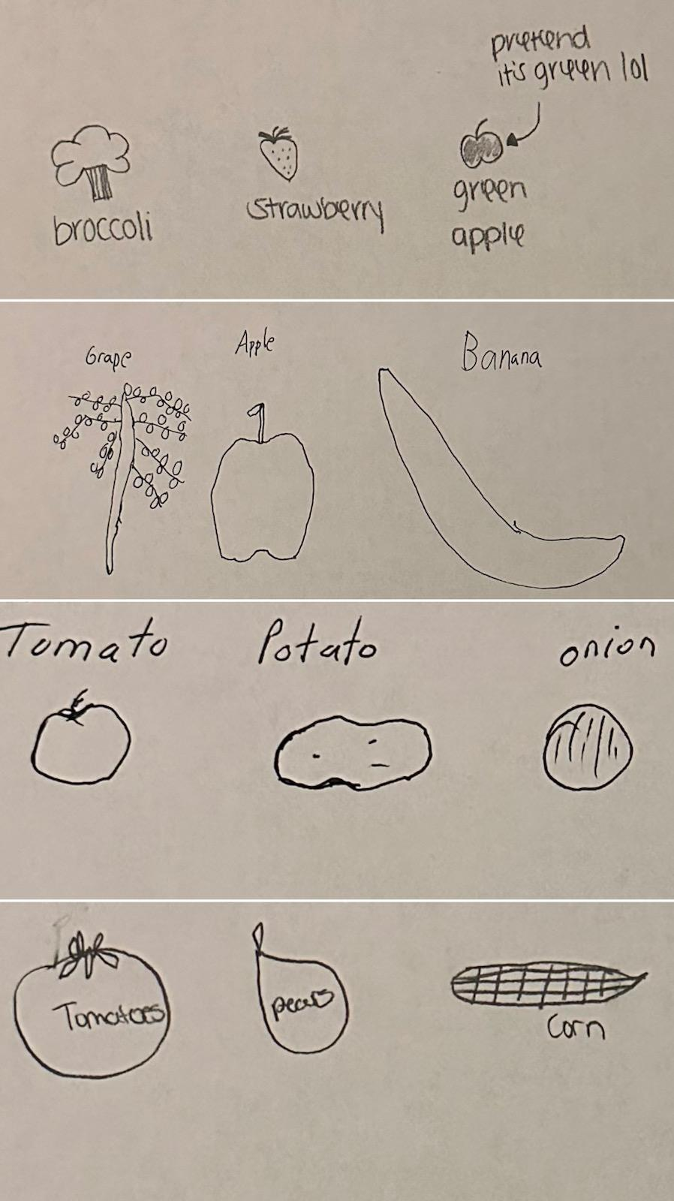
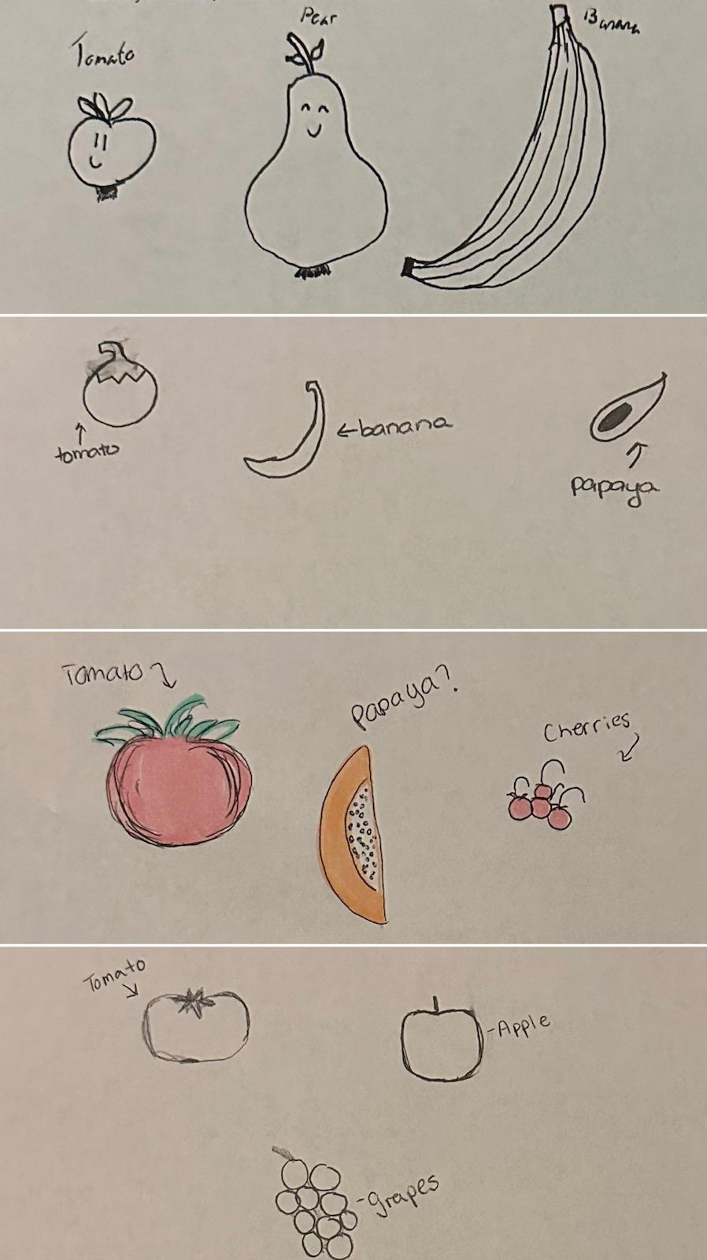
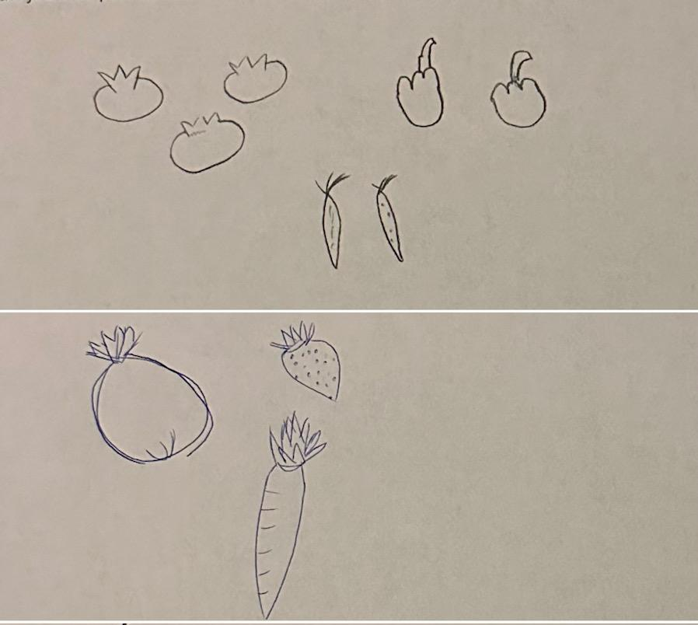

Slide 15
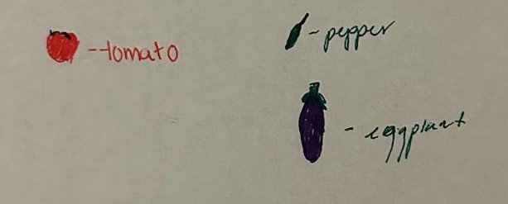

Slide 17
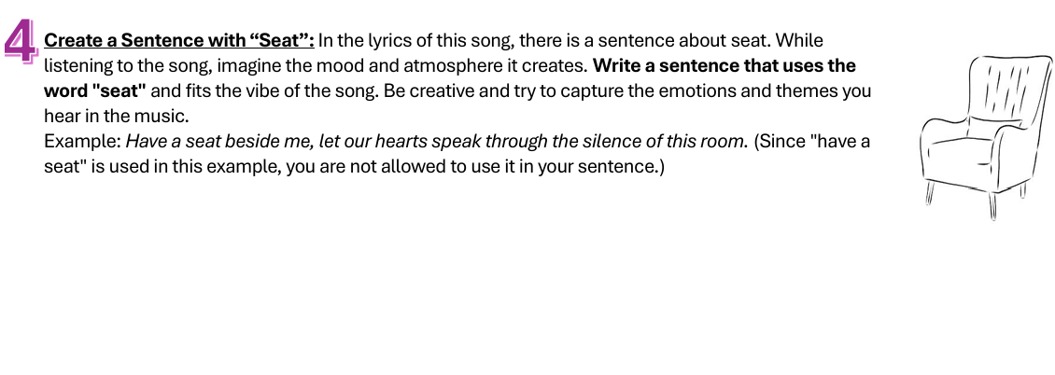

Slide 18
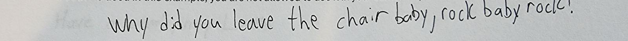
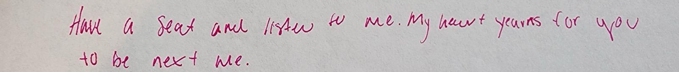
“Don’t steal the color of my lipstick
Let it stay upon my lips
Leave the seat across from me empty
Let our song play just for me”

Slide 19
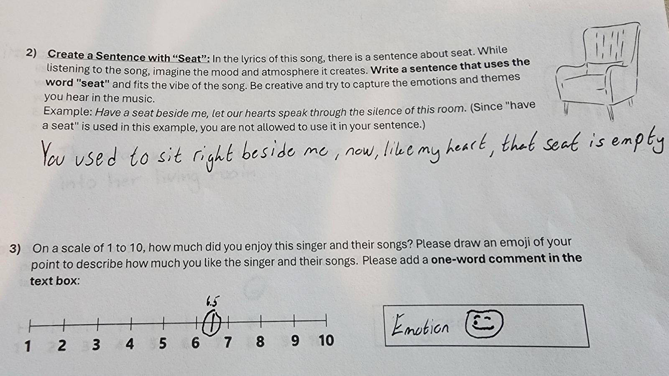

Slide 21
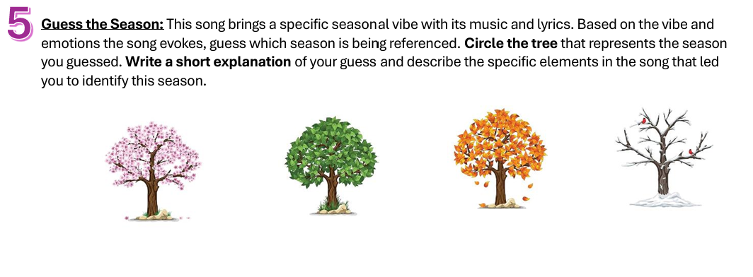

Slide 23
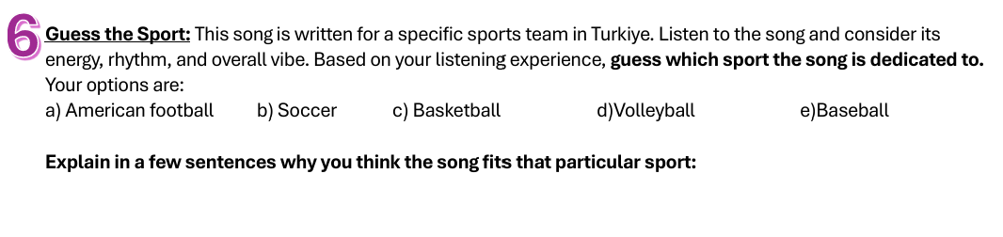
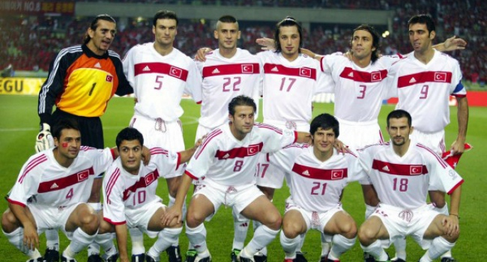
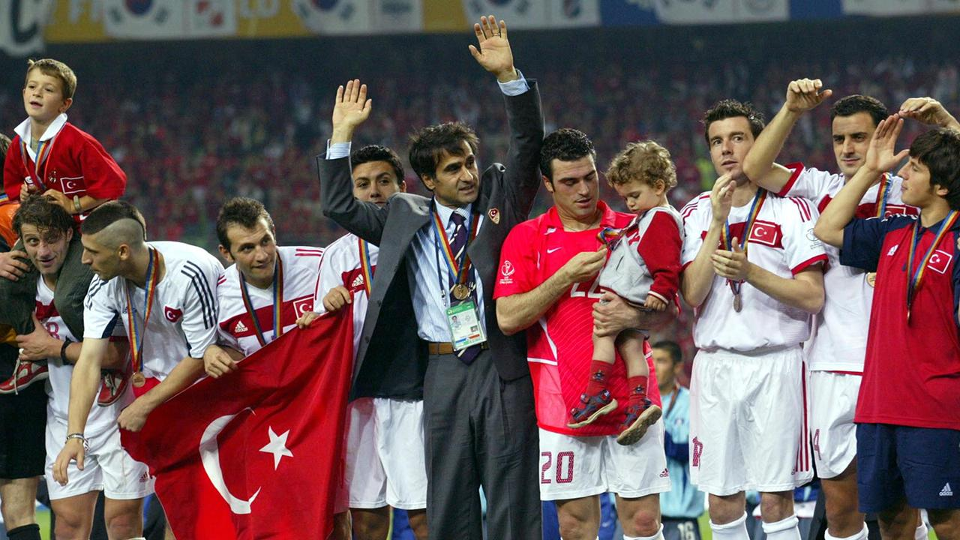

Slide 26
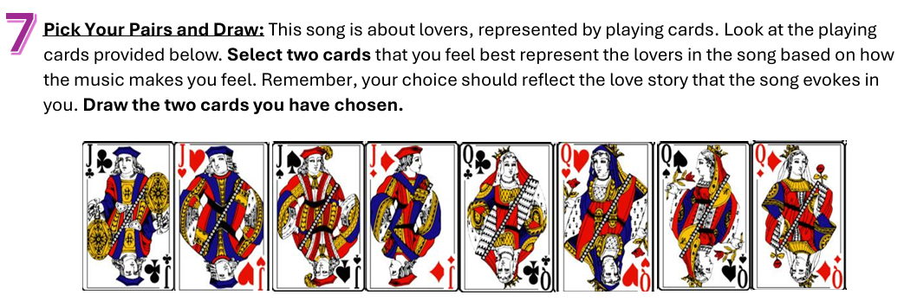

Slide 28
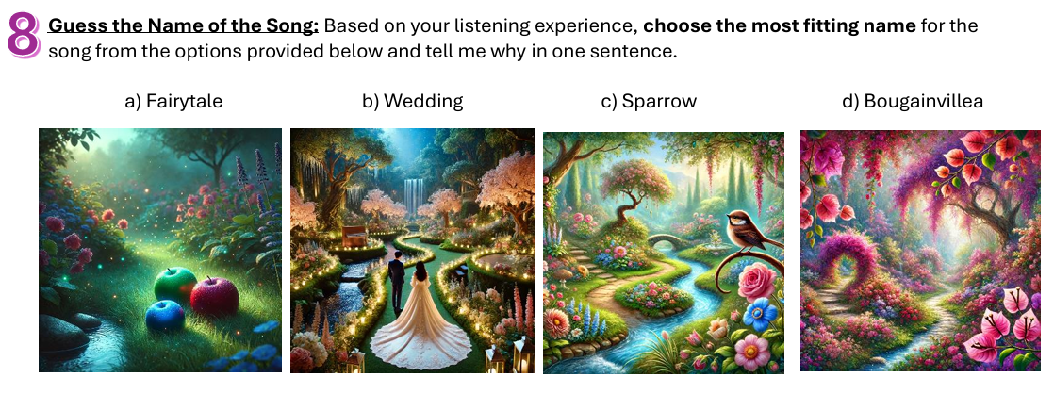

Slide 30
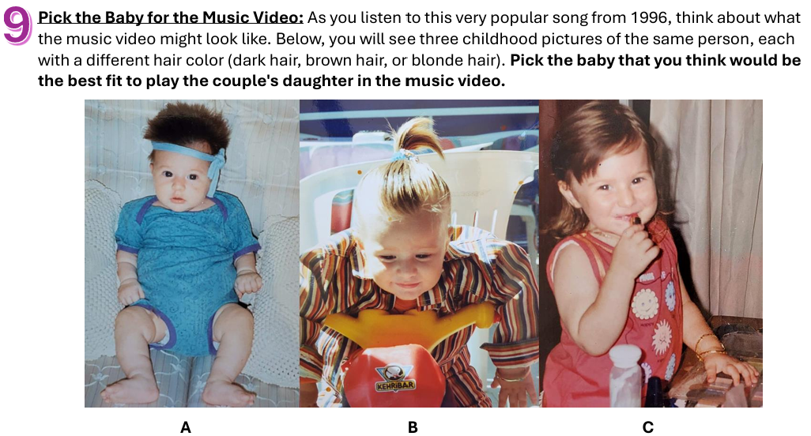

Slide 32
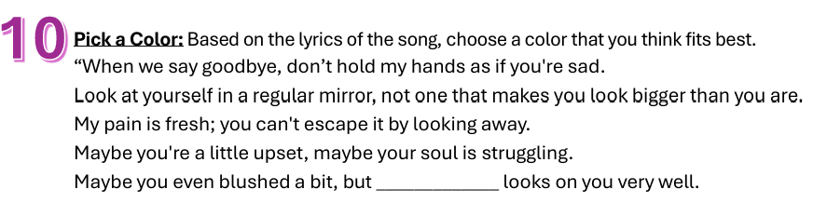

Slide 33
red

Slide 34
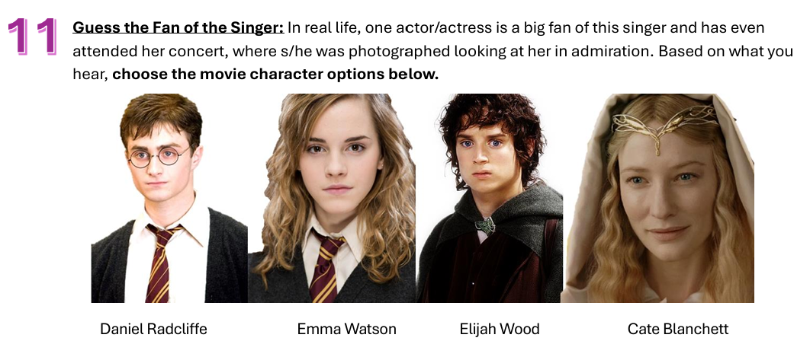

Slide 35

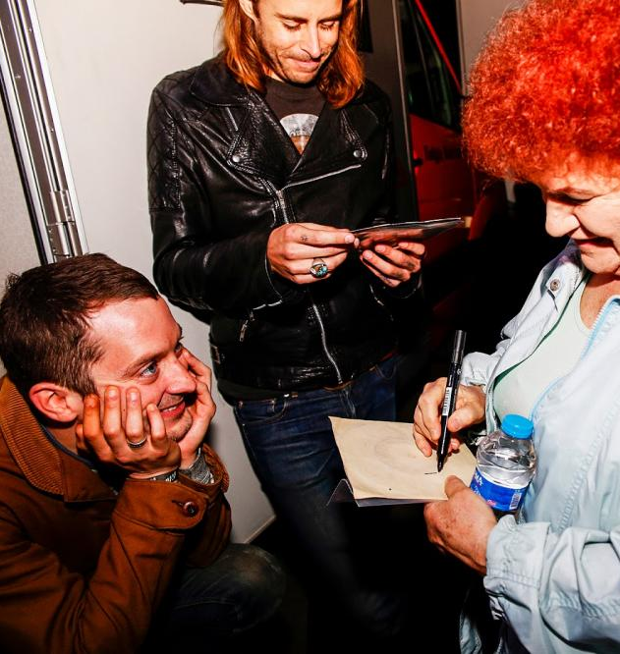


Slide 37
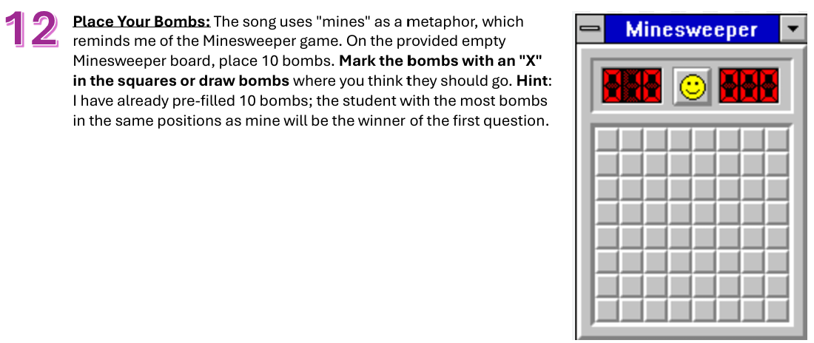

Slide 38
x
x
x
x
x
x
x
x
x
x

Slide 39
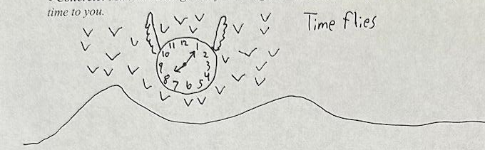
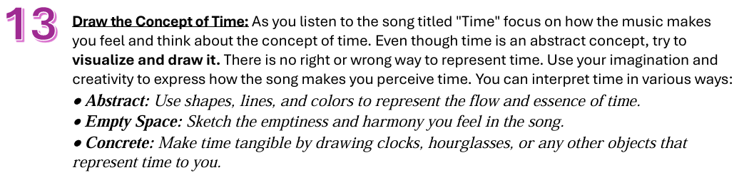
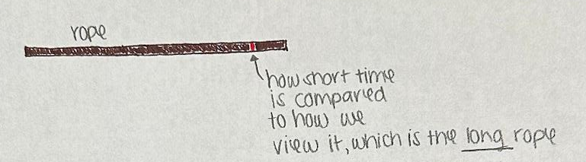
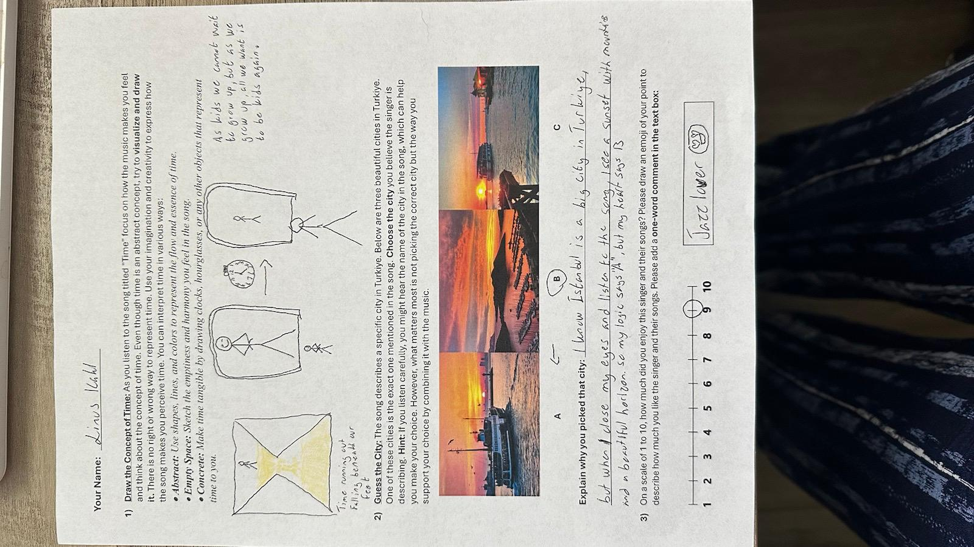
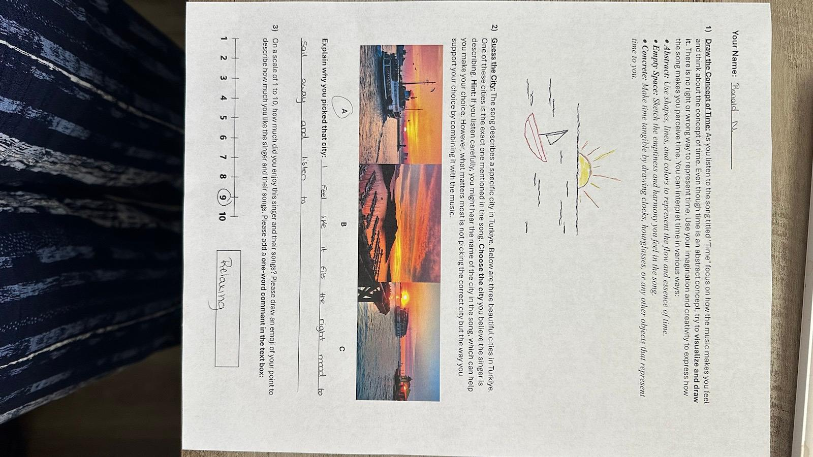

Slide 41


Oktoberbest Playlist Spotify Link
Cem Karaca – Ceviz Ağacı
Cem Karaca – Bu Son Olsun
Karsu – Domates Biber Patlıcan
Karsu – Bırak Beni Böyle
Candan Erçetin – Bahar
Tarkan – Bir Oluruz
Teoman – Kupa Kızı ve Sinek Valesi
Sertab Erener & Sezen Aksu & Levent Yüksel – Masal
Yaşar – Kumralım
Hande Yener – Kırmızı
Selda Bağcan – O Günler
Athena – Serseri Mayın
Jülide Özçelik – Zaman

Slide 42
DISCUSSION

Slide 43
Concern and Improvements
Do you have any concerns about how I’ve structured these music activities for my 8 AM course? Are there any areas you think could be improved?
What feedback do you have on the effectiveness of using music in this way? What could I tweak to make it even more engaging or impactful for my students?
Alternative Engagement Tools
This is a music activity. What other types of activities or tools do you think could be effective in engaging students at the start of an early morning class?
Tailoring Activities to Different Disciplines
What specific adaptations might be necessary to make this approach work within your teaching context?

Slide 44

Any Questions?

Slide 45



Thank you!
LinkedIn: Damla Sonmez
Instagram: phdamla

