Slide 1
Enhancing Student Engagement and Learning through Interactive Non-Linear Stories using Twine
Presented at Oktoberbest: A Symposium On Teaching
By Dr. Jerrod H. Yarosh Assistant Professor of Sociology at the University of South Carolina-Lancaster
10-25-24: University of South Carolina-Columbia

Slide 2
Agenda
Introduction and Goals of this session
What is an Interactive Non-Linear Story
Why it can enhance engagement and learning
Brief overview of Twine
Example/Live Demonstration via Twine
Summary and Q&A

Slide 3
Introduction and Goals:
Participants after the session will be able to:
  Express what a non-linear interactive story is
  Formulate a rationale for using this technique/strategy within their course
  Articulate course content that could be used to create an interactive non-linear story

Slide 4

What is an Interactive Non-Linear Story

Slide 5
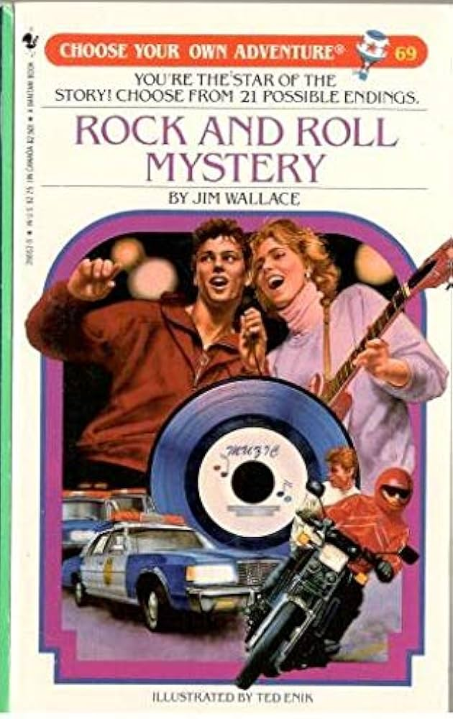
What is an Interactive Non-Linear Story
Any kind of story/experience where one has choices that shape and alter their experience/outcome
Variability in experience, the narrative/events are not always the same
Common starting point and then there can be overlap and variation through the rest of the experience
Example: Think of Massively Multiplayer Online games

Slide 6

Why Use Non-Linear Stories
From the students’ perspective:
  Doing is more active than listening
  Content delivered in a novel format increases interest
  An increased sense of agency
  Sense of autonomy in one’s learning
  Intrinsic motivation to learn
  Feels like time is being used purposefully

Slide 7

Why Use Non-Linear Stories
From the instructor’s perspective:
  It’s fun to create/think of the paths/options to offer
  It refreshes content that may seem stale
  I am excited to see how students respond
  Can be used across modalities
  Can be used for multiple purposes
  Higher engagement (ideally) equals more learning
  You might seem cooler to your students?!

Slide 8
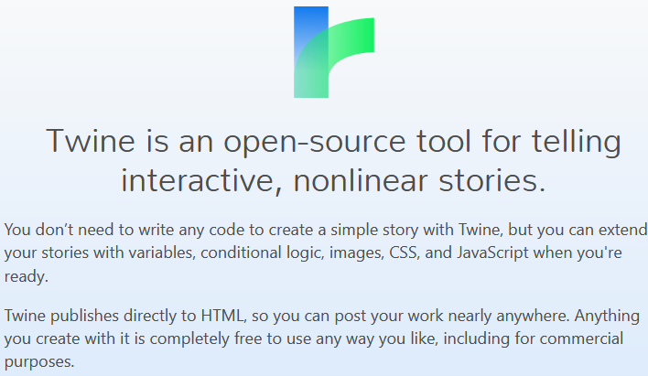
What is Twine?

Slide 9
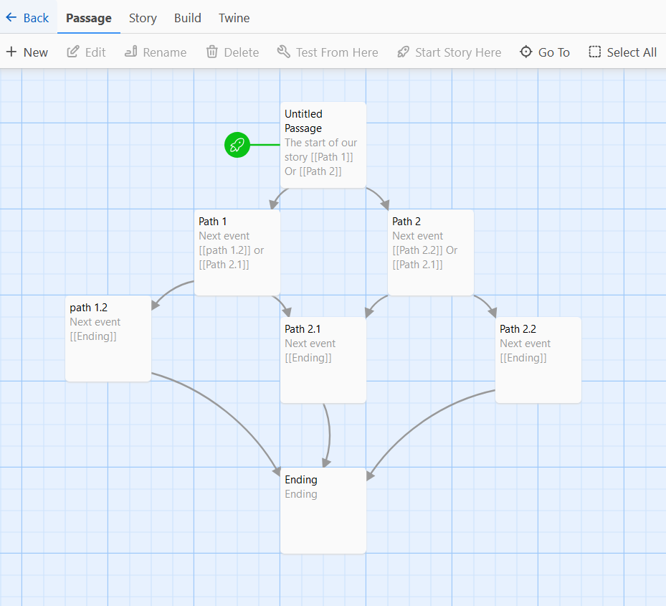
Work area:

Slide 10
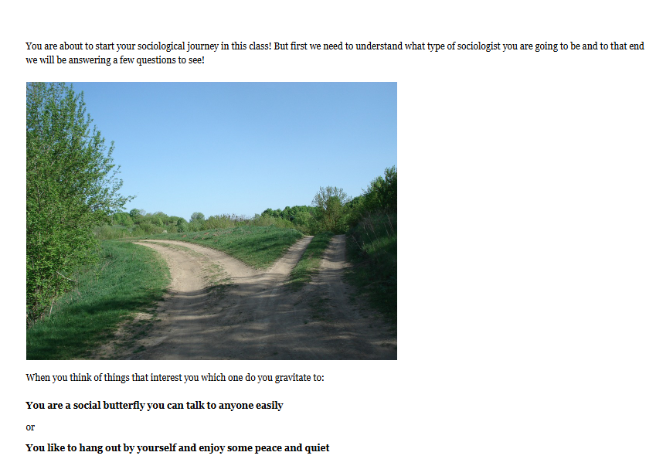
<-The look

Slide 11
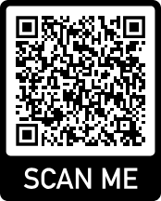

Attendee Participation Time!
Which Methodology are You? An Example of a Non-Linear Story!
(if time permitting/interest)
A live demo of how to use Twine: https://twinery.org/

Slide 12
Summary and Q&A
This can invigorate content and create an engaging learning experience
It provides an interactive alternative for course content presentation
Any course, discipline, and topic can utilize this technique
Formative, Summative, and Anything in between
Twine has a low learning curve and flexible/adaptable to one’s needs
Questions, Comments, Thoughts? Answers (hopefully)!
Thank you!

Slide 13
All pictures from www.pixabay.com
Or Twinery.org
Another example: https://playspent.org/

