Slide 1
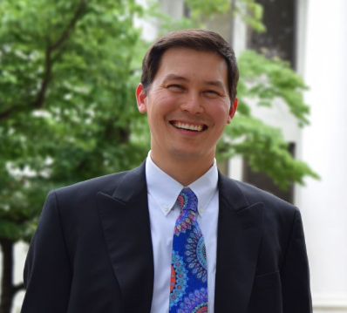

National Policy Document to Frame Equitable and Effective Undergraduate STEM Education
Dr. Sean Yee
University of South Carolina Oktoberfest 2024

Slide 2
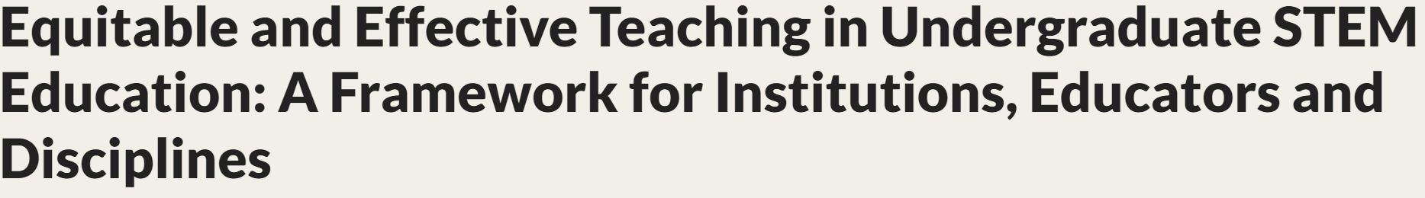
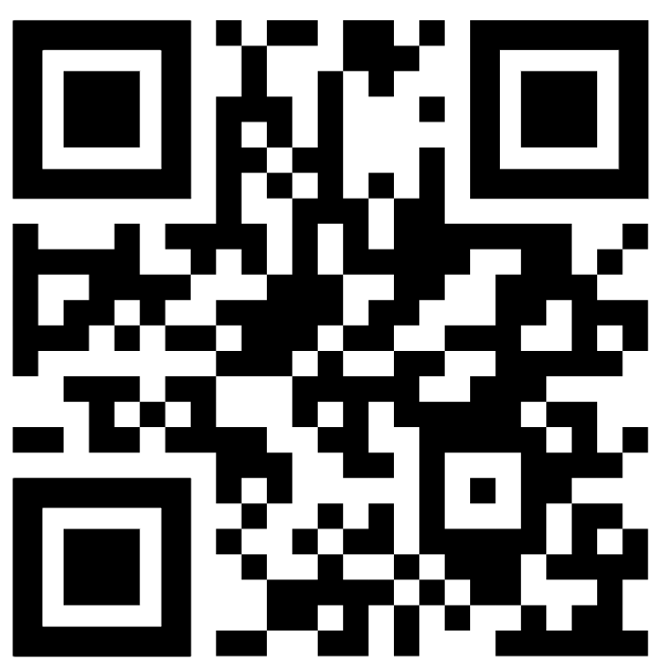
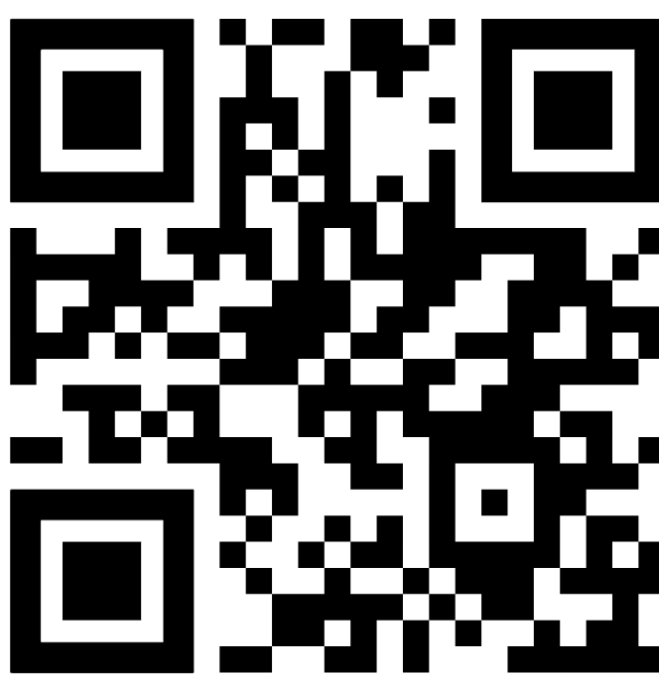
The committee conducted a two phase study.
Produce a discussion draft that outlines a framework for equitable and effective teaching.
Revise the framework, call out areas in need of further research, and provide guidance and recommendations for institutions, educators, and disciplines.
Finishing Phase 2, Final Report due out in December
K-12 (July, 2024) Undergraduate (December, 2024)

Slide 3
Charge of Study
Present a framework for equitable and effective teaching that includes attention to:
• Approaches to and guidelines for evidence-based, inclusive teaching;
• Equitable and effective teaching practices for different modes of teaching (e.g.,
in-person, online, blended and hybrid teaching), and different educational contexts (e.g., 2-year colleges, hybrid program, research institutions);
• The roles that technology does, or can in the future, play in supporting equitable
and effective teaching.
Discuss the experiences and training opportunities graduate students and postdoctoral students will need in order to be prepared to employ equitable and effective instruction as future faculty members.
Examine the institutional infrastructure, policies, and practices needed to encourage and support evidence-based teaching, such as opportunities for professional development, faculty evaluation policies and practices, and reward and advancement systems.
4. Provide actionable recommendations for institutions, disciplinary societies, funders, and policy makers on steps that could support implementation of the framework.

Slide 4
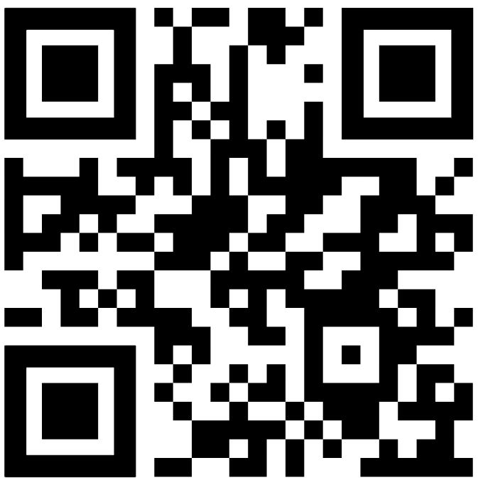
Full Public Draft
https://nationalacademies.org/docs/DEB1E504F32652B916F1716BE61F4DAF7004DDA4BDDA

Slide 5
7 Principles for the Framework
Cannot Separate Equitable and Effective.
Each principle is not designed to work alone.
Each principle is described so that it will be embedded at multiple levels
Student
Classroom
Instructors
Coordinators
Administration
Institution

Slide 6
15 Minute Think-Pair-Share
Prompts:
Which principles are you most comfortable implementing? Why?
Which principles are you most uncomfortable implementing? Why?
Which principles do you agree with or disagree with implementing? Why?
What principles do you feel are missing?

Slide 7
10 Minute Share Out and Questions
Prompts:
Which principles are you most comfortable implementing? Why?
Which principles are you most uncomfortable implementing? Why?
Which principles do you agree with or disagree with implementing? Why?
What principles do you feel are missing?

Slide 8
Thank You!
Dr. Sean Yee
yee@math.sc.edu

