Slide 1
Understanding the Health Information Practices of LGBTQ+ Communities to Improve Medical Librarian Services
Vanessa L. Kitzie
@vkitzie
Travis L. Wagner
@trlwagner
A. Nick Vera
@nickvera22
Notes:
Nick
Research funded by a three-year IMLS early career research grant

Slide 2
Introduction: Re-thinking deficit models
Deficit models focus on identifying problems & needs
Public health policy development addressing failures of individuals & communities to avoid disease (Morgan & Ziglio, 2006; Ziglio et al., 2000)
Library & Information Science (LIS) framing of “needy” individuals (Frohmann, 1992; Julien, 1999; Olsson, 2005)
Health librarianship focuses on universal medical information & education (Morris & Hawkins, 2016; Ma, et al., 2018)
Notes:
Research aims to challenge deficit models
Fields of public health, library and information science, and health librarianship
Public health
Historically used deficit models to examine problem and needs – leads to focus on individual and community failures at expense of what they're doing well
Widespread acceptance of socio-ecological model of health – holistic approaches not reflected in institutional structures, organizational decision-making and policy actions
Political, social, cultural, environmental, behavioral factors interwoven and play role in determining/sustaining health of population
LIS
Positions information need as central concept
Frames people's ignorance – rather than knowledge, as defining characteristic
Approaches conceive people as patients whose symptoms require diagnosis – inequity of power relations
Further seen in health librarianship – focus on universal medical information and education, means groups who don't follow or "fit" within "universal" are excluded

Slide 3
Today’s Presentation
Challenges deficit models
Leverages findings into implications for re-thinking medical librarianship and community outreach
Shares empirical findings from ongoing research exploring the health information practices of SC LGBTQ+ communities
Notes:
Challenge deficit models by-
Reporting empirical findings from our ongoing research examining the health information practices of SC LGBTQ+ communities
And finally, leverage our findings into implications for re-thinking medial librarianship and community outreach

Slide 4
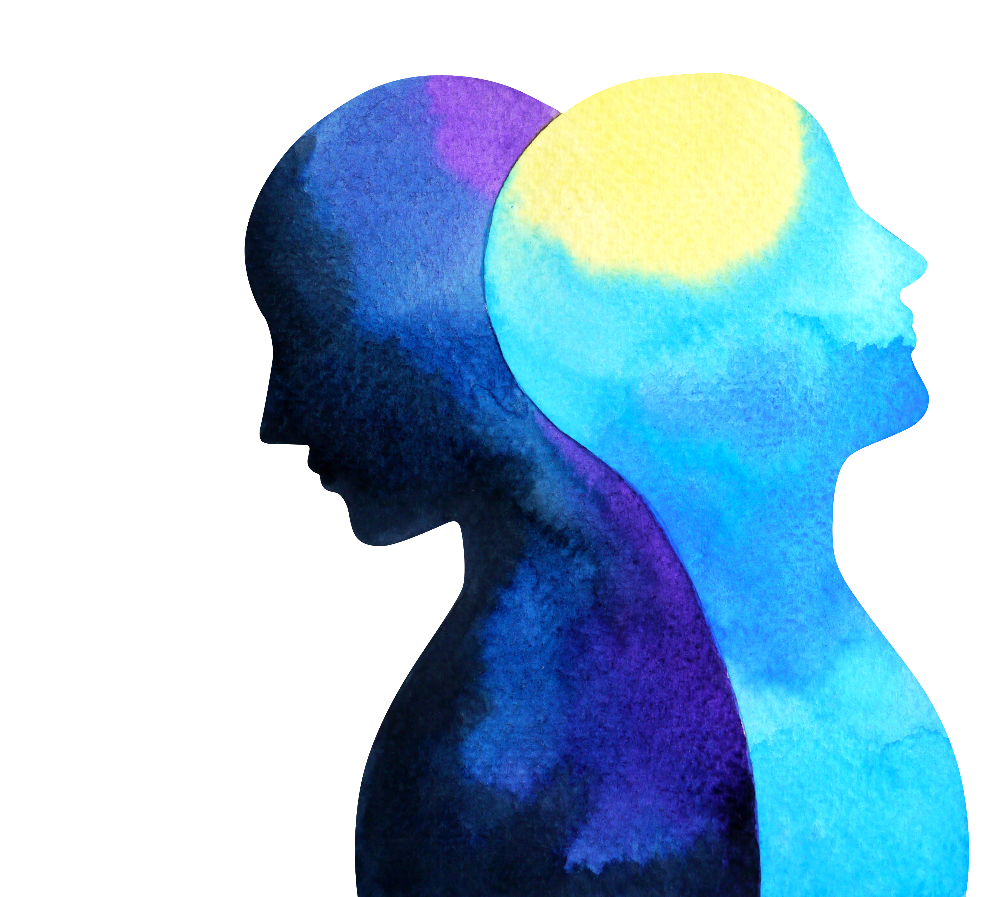
Context: About the research study
LGBTQ+ populations face serious health challenges (HealthyPeople, 2019)
Challenges are heightened in the Southern United States (Matthews & Lee, 2014; Williams Institute, 2019)
Informational barriers (Morris & Hawkins, 2016; Romanelli & Hudson, 2017)
Notes:
LGBTQ+ people face health challenges compared to heterosexual and cisgender peers
Challenges are produced by social and structural factors such as legal discrimination and access to health services
Factors produce health disparities
Can be at LGBTQ+ level
E.g., LGBTQ+ populations have highest rates of tobacco, alcohol, and other drug use than non-LGBTQ+.
Can be specific to certain groups
E.g., transgender POC have higher rates of victimization as compared to LGBTQ+ and non-LGBTQ+
Health challenges enhanced in South, where LGBTQ+ people experience greater discrimination, more isolation
In SC LGBTQ+ people have:
Heightened economic instability
Unemployment
Lack of health insurance
…. As compared to national averages
Also experience enhanced discrimination due to LGBTQ+ identity
An relatively unaddressed factor contributing to LGBTQ+ health challenges are informational barriers, such as:
Difficulty learning about healthcare needs
Navigating healthcare system
Addressing barriers to care

Slide 5
Research questions
RQ1: How does sociocultural context shape the health information practices of SC LGBTQ+ communities?
RQ2: What are the implications of research findings for LIS education, specifically health librarianship?
Notes:
Gaps in the literature led informed our research questions (read questions)

Slide 6
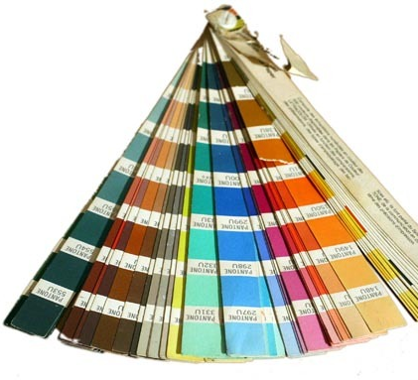
Methods
30 SC LGBTQ+ community leaders ages 13+
IRB waiver of parent/guardian consent
Sampling: Purposive, Snowball, Theoretical
Semi-structured interviews
Information worlds mapping (Greyson, 2013)
In-person interviews (with exception of 2 telephone)
Interviews audio-recorded & transcribed
Open qualitative coding (Strauss & Corbin, 1994)
Validity: Team coding meetings, member-checking, multiple data collection methods
Pseudonyms used
Notes:
Happy to provide more in-depth methods info during discussion
Interviewed 30 SC LGBTQ+ community leaders
Leaders provide a bird’s eye view of their communities
Emailed a list of 100+ LGBTQ+ and affinity organizations in SC asking them to nominate a community leader to participate
Asked leaders to recommend other participants
Used theoretical sampling to inform social media recruitment
Important to note that leaders can be youth; IRB waiver for parent/guardian consent
Semi-structured interviews averaged 78 minutes and covered:
Community involvement identities, health questions/concerns, and practices for addressing questions/concerns
Following interviews, participants engaged info worlds mapping, a visual elicitation method, to provide a diff. way to address interview themes
Data consisted of interview transcripts, field notes, and info world maps
Focus on transcript analysis for this presentation
Met as a group to hand-code three transcripts and build a preliminary codebook
Refined codebook using four additional transcripts
Constantly compared emergent and existing codes, resolving discrepancies among coders
Then coded remaining transcripts independently
Engaged in member-checking where participants accessed their transcripts to comment on how well they reflected lived experiences, as well as highlight any identifying info

Slide 7
Participant Demographics
Table 3. Education
Education | n | %
Some college credit | 7 | 24%
Master’s degree | 6 | 20%
Associate degree | 5 | 17%
Bachelor’s degree | 5 | 17%
In high school | 2 | 7%
In middle school | 2 | 7%
High school diploma | 1 | 4%
Doctoral degree | 1 | 4%
GED or alt. credential | 1 | 4%
Table 1. Age Range
Age | n | %
18-25 | 11 | 37%
35-54 | 7 | 24%
55-64 | 4 | 14%
13-17 | 4 | 14%
26-34 | 3 | 10%
65+ | 1 | 4%
Table 2. Race & Ethnicity
Race & Ethnicity | n | %
White | 18 | 60%
Black | 7 | 24%
Black, White | 2 | 7%
Black, Afro-Caribbean | 1 | 4%
Aboriginal, Arab/West Asian, Black, White | 1 | 4%
Black, White, Egyptian | 1 | 4%
Notes:
Majority of participants were young adults (18-25) and middle-aged
Race/ethnicity reflects that of LGBTQ+ people at broader state-level
Under-representation of Latinx communities, which have presence in SC
Education varied, but common for participants to have some degree of higher education

Slide 8
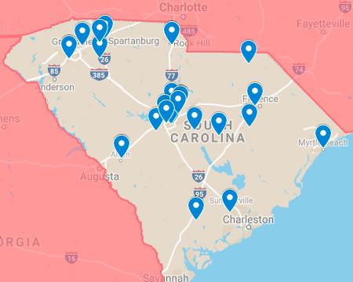
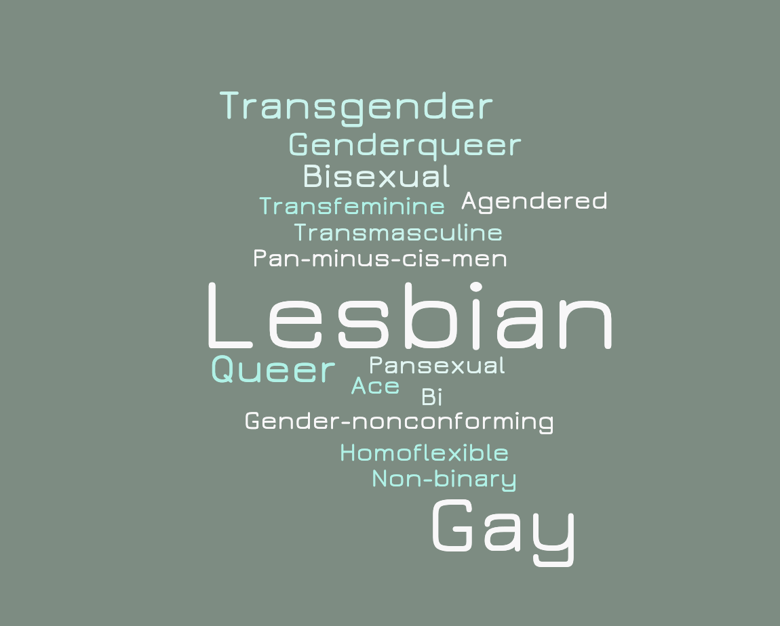
Participant Demographics
Notes:
Geographic distribution spread across the state, with concentrations in Upstate and Midlands regions
Fewer participants in Coastal Lowcountry and Pee Dee regions reflect smaller populations and less visible organizations
Charleston has an active, visible LGBTQ+ population, but did not participate in interviews
While most participants identified as lesbian and gay, they used other labels to describe sexualities and gender identities
Denotes inability of umbrella labels like LGBTQ+ to capture multiplicity and fluidity of participant identities

Slide 9
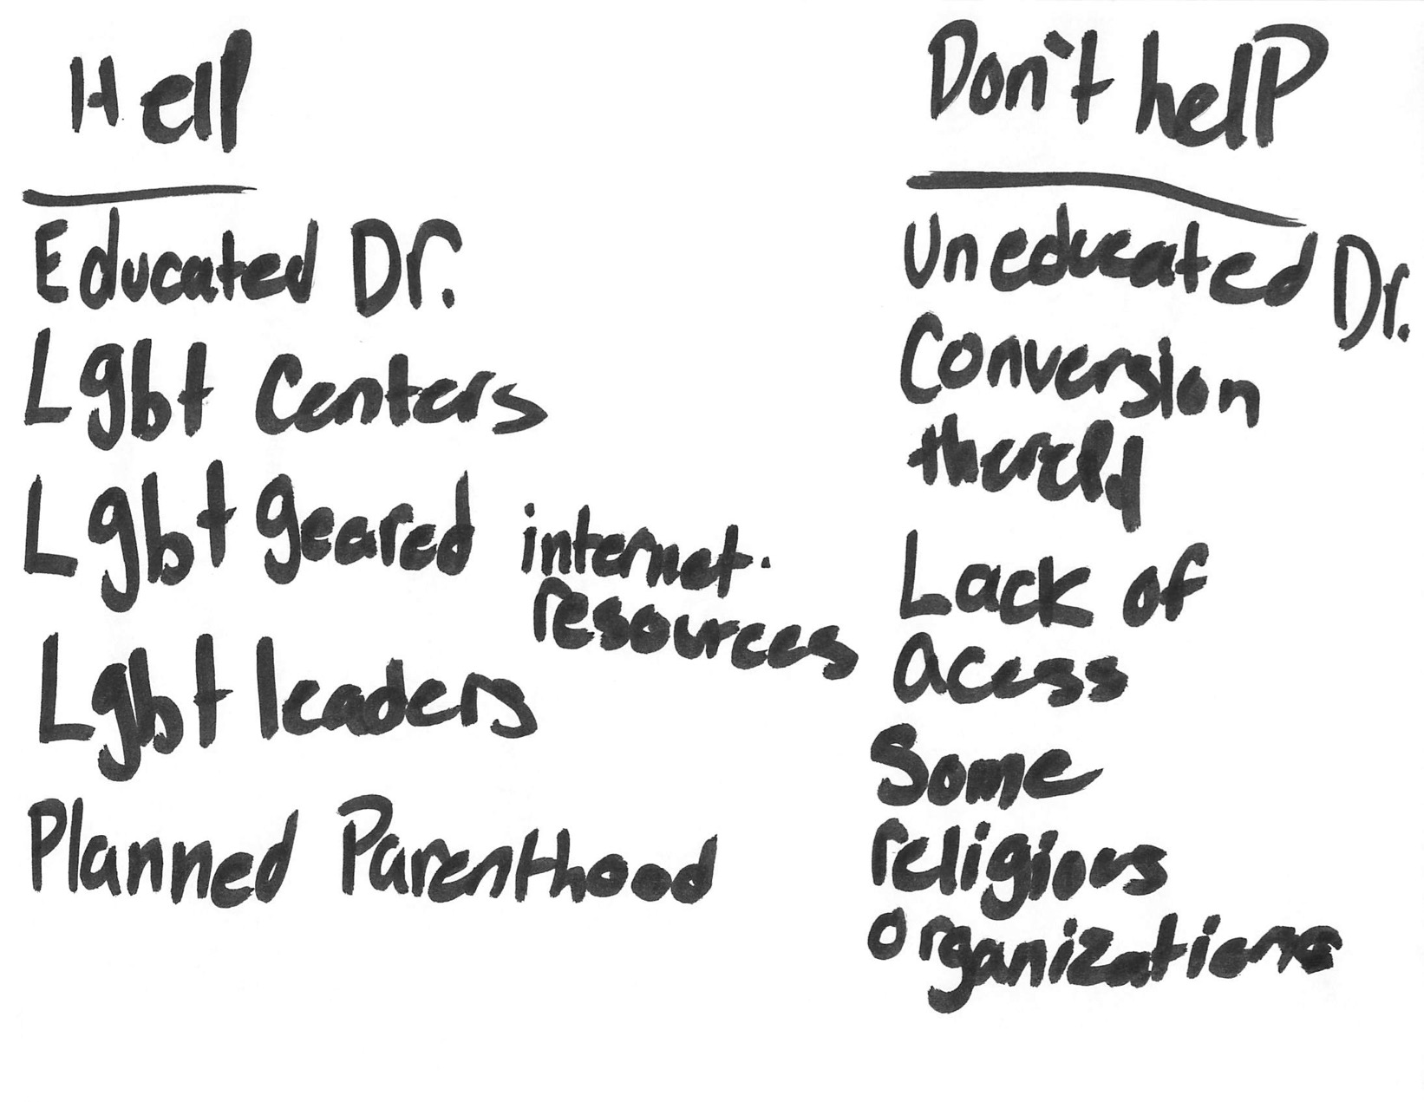
Vada’s Map
Notes:
Rather than show you conceptual models, I have a few examples of participants’ information worlds maps, so you can see the participants’ thoughts and own ideas, rather than our interpretation of them.
This map is from Vada, a white, young adult lesbian who uses she/her pronouns. She serves as a local LGBTQ+ youth group leader.
When asked about her information map, she decided to fixate on what helps and what does not help, both of which are depicted in the two lists
Read list
To expand on her map (next slide)

Slide 10
Vada’s Quote
“There aren't many doctors who are willing to listen. And there aren't many therapists that we know of who are good therapists, A, and B, willing and capable of treating complex LGBT issues. Because they are complex. They're different from another standard […] It's different than treating somebody who is straight because the issues […] might be the same in diagnosis, but they're different in causation. So depression from somebody who's LGBT might be because their family has rejected them. Whereas someone who's straight might have depression because their dog died. That's very different. And trying to treat it is going to be very different. So that seems to be a problem. And there's just not a lot of resources because a lot of LGBT people live in poverty. And a lot of LGBT people do not have access to a regular health care. So things like they can't get access to regular STI or STD testing, which is why popup clinics are so important. They can't get the treatment that they need all the time […] Especially the youth. And then trans women, I find especially […] but trans men have this issue, too, but trans women especially, I feel, have to find alternative ways to get their hormones because there's very few […] trans women have a harder time passing, usually, then trans men. And they're desperate to be on hormones because it changes things. And when doctors aren't willing to prescribe it because they don't understand, it can make it very challenging for them.”
Notes:
Read quote
After reading this quote, we can see the connection from the interview to her map.
Specifically she addresses barriers such as doctor biases, financial limitations, and how doctors can be unwilling to treat members of the LGBTQ+ population, especially those members who identify as trans who are seeking hormones

Slide 11
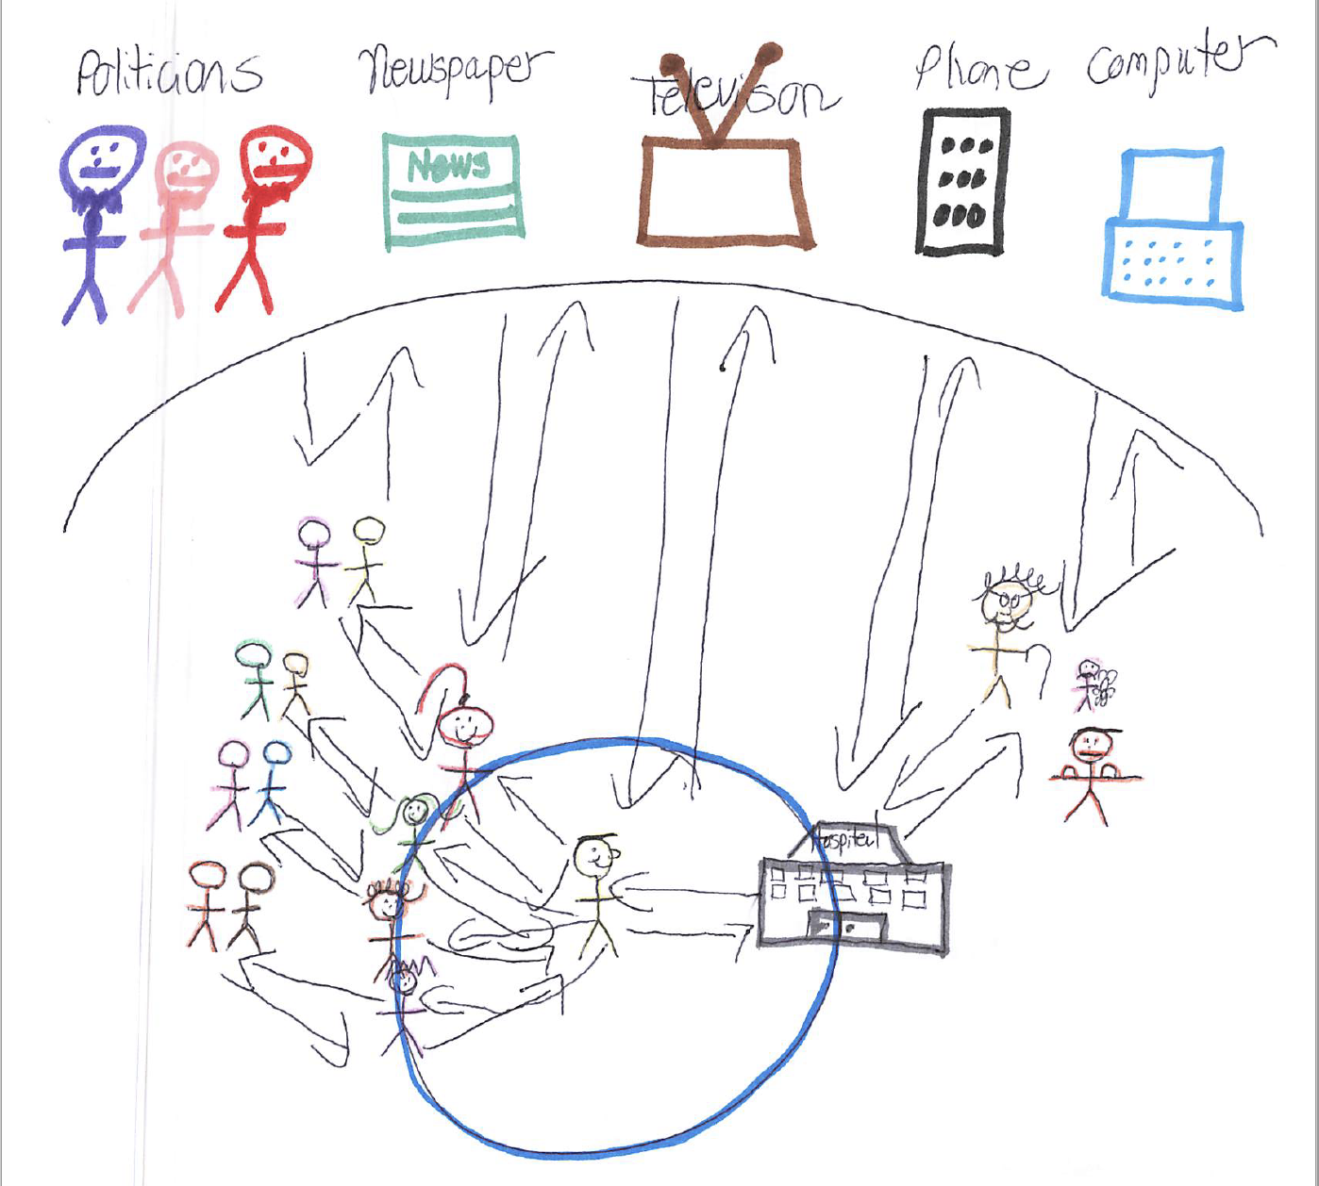
Jake Hartwell’s Map
Notes:
This next map was created by Jake Hartwell, a young, black healthcare professional who identifies as gay and uses he/him pronouns.
In Jake’s interview, he discusses his relationship with his place of work and what health information his community receives
At the top, we can see that there are many sources that members of his community receive information from, including politicians, media, and online.
What’s unique about his map are the arrows that show the relationship between information and people, and how information brings them to healthcare spaces. What’s not seen here that we get from his interview, which I’ll show you in a moment, are the barriers members of his community face to accessing healthcare, which the relationship between the person, information, and the healthcare space.

Slide 12
Jake Hartwell’s Quote
“[STATE] ranks one of the worst in just health care in general and how people receive health care and people wanting to receive health care. And one of the challenging things is that people have a hard time wanting to get access to things, or people have a hard time wanting to seek services because of all these barriers to access. Lack of insurance, lack of knowledge about what it is that's making them sick. Sometimes it's transportation. Sometimes it's provider bias. I work with a lot of amazing doctors and nurses. I also work with a lot of judgmental doctors and nurses”
“The issues I found in provider bias is that quite a few doctors I work with tend to be kind of a little bit more judgmental when it comes to LGBTQ population. In particular, is that every LGBTQ person, they order HIV test on, and many of them asked them if they have HIV. Typically, when a patient comes in, we ask that as part of our assessment, but not everyone gets that ordered. If a patient says, "I don't know. I've been tested," or, "I want to get tested," usually, we order it, but if they say, "No. I get tested regularly," or like, "I'm not sexually active," or whatever, we don't necessarily do that. And so, for me, that's an example of bias because in my mind, if you are ordering these tests for the LGBTQ population, you should order this test for everyone. I don't think that that's an okay practice to do, and again […], but there are some providers I kind of scratch my head when it comes to that because I'm like, "Just because someone is LGBTQ, doesn't mean they have HIV."
Notes:
Read quote
From this quote, as opposed to his map, we see the barriers to accessing healthcare, which include financial barriers, lack of insurance, and doctor biases, especially when it comes to sexual health.
As a healthcare professional, Jake gets to see a different side of things, he follows up with patients, ensuring that they have the resources and information they need to maintain a good quality of life. However, this is complicated by doctors who are judgmental in how they treat LGBTQ+ patients, specifically with assuming they are engaging in risky sexual practices simply because of their identity. This in turn creates a mistrust between patients and doctors, which may lead them to not seek help.

Slide 13
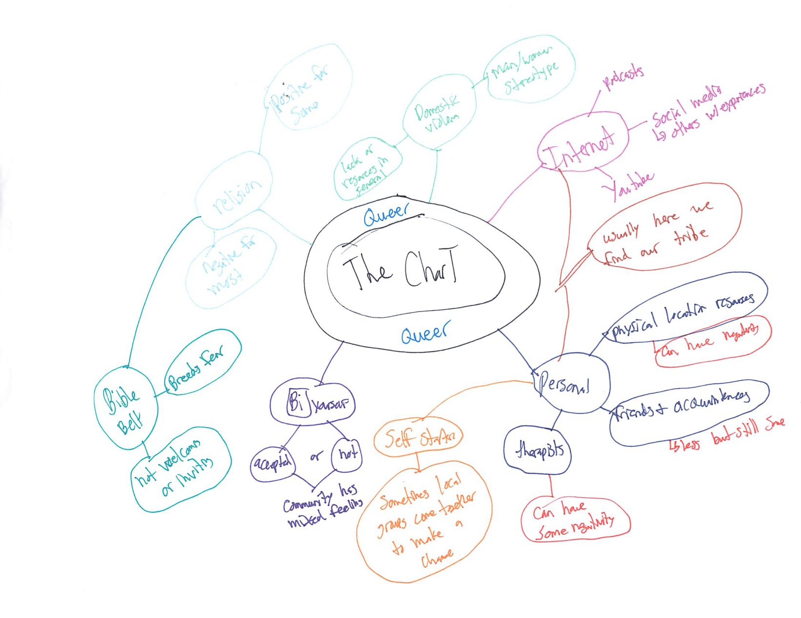
annalisa’s Map
Notes:
This final map comes from Annalisa. Annalisa is a small business owner who identifies as lesbian and uses she/her pronouns.
In Annalisa’s map, we see a stark difference from both Vada and Jake’s maps.
Where some participants are influenced by cultural institutions like politicians and the media like we saw on jake hartwell's map, others like Annalisa structure and organize their maps using those institutions like the ( I word, a TV show with lesbian representation) to create their map.
Here we’re able to see the relationship between the queer community and the various information sources they use and avoid to stay healthy.
On the left, we see religion, which isn’t connected to the other information sources, but as Annalisa explains in the interview, is a source that members of the queer community are aware of and can’t avoid.

Slide 14
Annalisa’s Quote
“I guess when if someone finds a good doctor that's accepting in our [pain?], we'll definitely tell each other about it, "I finally found a better gynecologist who is more accepting and doesn't grill every time." So that's was nice. I guess just kind of sharing different information. How this happened, how, if there's a doctor that does hormones or a clinic or somewhere. I know people who group together and go so they can all try to save on transportation and start their FundMe pages to do this. Just trying to spread the word.”
“Lack of access to domestic violence things, just in general. If someone, even if it's not DV, just trying to get the crime actually investigated and a sense of justice. Not having, especially with AIDS and the stigma of that, not having necessarily treatment, access to treatment, expensive drugs, and just the stigma of around it. That's one of the biggest problems.”
Notes:
When asked about her community and how people within it stay healthy, Annalisa states that…
and more into our interview I asked Annalisa, “So what health issues do your community members experience? Her response,
- So barriers here include financial barriers, stigma, and transportation. She also highlighted the injustice regarding domestic violence in the LGBTQ+ community, as many individuals struggle to get their cases investigated, let alone prosecuted.

Slide 15
key finding’s
Vada
Gender identity and sexual orientation produce barriers (hetero / cis-normativity, homo /trans-phobia) which can facilitate doctors' unwillingness to listen or treat their patients.
Jake Hartwell
Financial barriers, lack of insurance, doctor biases and information sources act as barriers to community members accessing health care.
Annalisa
Stigma, lack of transportation, financial barriers, and intimate partner violence discussions presume heterosexuality resulting in Annalisa experiencing erasure and silence around being a member of the LGBTQ+ and having experienced IPV
Notes:
Contextual conditions are underlying circumstances shaping how individuals and communities interact with health information
In Vada’s example gender identity and sexual orientation are important conditions
Contextual conditions produce barriers
Barriers are obstacles that constrain individuals and communities from achieving certain informational outcomes
Hetero and cisnormativity are barriers
Represent the idea that being straight and being cisgender are “standard” – anything that deviates from this standard assumption is invisible and abnormal
Homophobia and transphobia are also key barriers
Represent the active negative attitudes toward those who are not straight/cisgender
Both sets of barriers can
Get people kicked out of their homes
Can lead to negative consequences for those who cannot “pass” as a certain gender identity
Contribute to medical professionals’ unwillingness to listen
Barriers, in turn, shape how individuals and communities create, seeking, share, and use health information
In Vada’s example, trans women may find alternate ways to get hormones in response to barriers experienced
Shows how what we might take to be a “risky” practice on the surface (i.e., finding alternate ways to get hormones) is actually well-informed based on communities’ well-reasoned responses to contextual conditions and the barriers they produce
- So barriers here include financial barriers, stigma, and transportation. She also highlighted the injustice regarding domestic violence in the LGBTQ+ community, as many individuals struggle to get their cases investigated, let alone prosecuted.

Slide 16
Implications for health librarianship
Re-orienting professional practice rather than “fixing”
Shift from outreach to engagement (Baba & Abrizah, 2018)
Partnering with community health workers (Raj et al., 2015)
Cultural competency trainings to medical professionals (Cooke, 2017)
Harm reduction workshops (Pollack, 2008)
Notes:
If we accept communities as being knowledgeable about navigating the larger social and structural factors shaping their health information practices, then we need to rethink critical assumptions of our practice
Note that all of these implications are interrelated
Outreach vs. engagement – what are the differences?
Outreach = provision of resources to community members
Engagement = applying expertise to issues of public concern; partnering with community members in a way that is beneficial (definitions of engagement seem to vary based on the agency given to community members regarding decision-making)
E.g., discussion with research participants about what libraries can do for them – one suggestion is libraries maintaining a list of LGBTQ+ friendly doctors
Outreach = just providing a list
Engagement = looking into issues that librarians are experts in – e.g., persistence (doctors move, doctors go away), information value (especially TRUST) in order to create and maintain list over time; requires partnership with community
Partnering with community health workers
CHWs = highly trusted members of communities that act as critical information intermediary between community and medical/information professionals
Studies of CHWs show that they experience significant informational challenges when performing their jobs
Opportunity for health librarians to partner with CHWs, are guided by them (not the other way around)
Cultural competency trainings for medical professionals
Trainings can be developed/guided by LGBTQ+ communities
Given to local health professionals at library
Librarians’ role is as facilitator, not expert
Everyone engages in risky behaviors
Risk when driving a car, when engaging in sexual activity
Harm reduction = wearing a seatbelt; using protection
Other types of harm reduction strategies are stigmatized, such as how to address challenges of encountered when self-prescribing hormones, engaging in sex work, using drugs
BUT these activities are INFORMED and often NECESSARY due to social and structural factors for LGBTQ+ people and other marginalized groups
Need to normalize harm reduction with focus on specific challenges experienced by LGBTQ+ communities

Slide 17
Future Directions
Shift focus groups from LGBTQ+ leaders to community members.
Expand recruitment to include more underrepresented participants in our current sample.
Conduct interviews with medical practitioners, community health workers, and medical and health librarians.
Notes:
I.e., latin x, poc, youth, people living in rural areas of SC and beyond.
This research has several future directions. Our next step is to conduct focus groups with participants’ communities to validate and expand the current findings from our leader interviews. We’ll also work on employing more nuanced and embedded strategies to recruit participants who are underrepresented in the current sample. In the future, we’ll also conduct interviews with health and medical librarians, in addition to medical professionals, to better understand their information practices in relation to the LGBTQ+ communities they serve.

Slide 18
Thank you!
Questions?
For more project info:
http://bit.ly/hiplgbtq
Notes:
Val

Slide 19
References
Baba, Z., & Abrizah, A. (2018). Transformation strategies in community engagement: Selected initiatives by Malaysian libraries. IFLA journal, 44(2), 90-105.
Cooke, N. A. (2016). Information services to diverse populations: Developing culturally competent library professionals. ABC-CLIO.
Frohmann, B. (1992) The Power of Images: A Discourse Analysis of the Cognitive Viewpoint. Journal of Documentation, 48, 365-386.
Greyson, D. (2013). Information world mapping: A participatory, visual, elicitation activity for information practice interviews. Proceedings of the American Society for Information Science and Technology, 50(1), 1-4.
Julien, H. (1999). Where to from here? Results of an empirical study and user-centred implications for information design. In T. D. Wilson and D. K. Allen (Eds) Exploring the Contexts of Information Behaviour, (pp. 586-596) London, Taylor Graham.
Ma, J., Stahl, L., & Knotts, E. (2018). Emerging roles of health information professionals for library and information science curriculum development: a scoping review. Journal of the Medical Library Association: JMLA, 106(4), 432.
Matthews, D. D., & Lee, J. G. (2014). A profile of North Carolina lesbian, gay, and bisexual health disparities, 2011. American journal of public health, 104(6), e98-e105.

Slide 20
References
Morgan, A. & Ziglio, E. (2006) Foreword. In: Capability and resilience: beating the odds. Department of Epidemiology and Public Health, University College London, London.
Morris, M., & Hawkins, B. (2016). Towards a new specialization in health librarianship: LGBTQ health. Journal of the Canadian Health Libraries Association, 37(1), 20-23.
Olsson, M. (2005). Beyond ‘needy’ individuals: conceptualizing information behavior. Proceedings of the American Society for Information Science and Technology, 42(1).
Pollack, H. (2008). Moral, prudential, and political arguments about harm reduction. Contemporary Drug Problems, 35, 211 - 239.
Raj, S., Sharma, V. L., Singh, A., & Goel, S. (2015). The health information seeking behaviour and needs of community health workers in Chandigarh in Northern India. Health Information & Libraries Journal, 32(2), 143-149
Romanelli, M., & Hudson, K. D. (2017). Individual and systemic barriers to health care: Perspectives of lesbian, gay, bisexual, and transgender adults. American Journal of Orthopsychiatry, 87(6), 714.
Williams Institute (2018). LGBT people in South Carolina. Retrieved from: https://williamsinstitute.law.ucla.edu/wp-content/uploads/South-Carolina-fact-sheet.pdf
Ziglio, E., Hagard. S. & Griffiths, J. (2000) Health promotion development in Europe: achievements and challenges. Health Promotion International vol 15, no. 2, pp. 143-153.

